Slide 1






Computer Architecture
with gem5
NEXT-GEN COMPUTING & HARDWARE SECURITY
CORE 0
CORE 1
L1
L1
Hands-on gem5 simulation with AI-guided learning
SHARED L3
Wednesday, Oct 28, 2026
IF
ID
EX
MEM
WB
CORE 2
CORE 3
IF
ID
EX
MEM
WB
L1
L1
10 AM – 2 PM ET
IF
ID
EX
MEM
WB
IF
ID
EX
MEM
WB
FIU EC3930 & on Zoom
IF
ID
EX
MEM
WB

Slide 2




A Hybrid Event Organized by MEST Center and FIU
A Workshop Organized by MEST and FIU
Next-Gen Computing and Hardware Security
Computer Architecture with gem5
Interactive Microarchitectural Analysis and Exploration
Wednesday, 28 October 2026
10:00 AM – 2:00 PM ET
Room EC 3930
Department of Electrical & Computer Engineering
Hybrid Event
In person and online

Slide 3




Meet the Team
INSTRUCTOR
INSTRUCTOR
STUDENT ASSISTANT
Dr. Md Tauhidur Rahman
Sagor Chandro Bakchy
Luciana Di Campli
Assistant Professor
Ph.D. Student, SeRLoP Research Lab
MS Student
Electrical and Computer Engineering, FIU
Electrical and Computer Engineering, FIU
Electrical and Computer Engineering, FIU

Slide 4
01
02
03
Configure and Execute
Set up gem5 environment, compile binaries, and execute simulations
Inspect Pipeline Hazards
Analyze data hazards, pipeline stalls, and branch prediction
Cache Memory Trade-Offs
Evaluate cache hit/miss ratios, associativity, and latency
Agendas for the Event
04
05
Microarchitectural Security
Analysis of attacks and design of secure systems
AI Scaffolding Learning
Learning with AI intelligent tutoring system

Slide 5
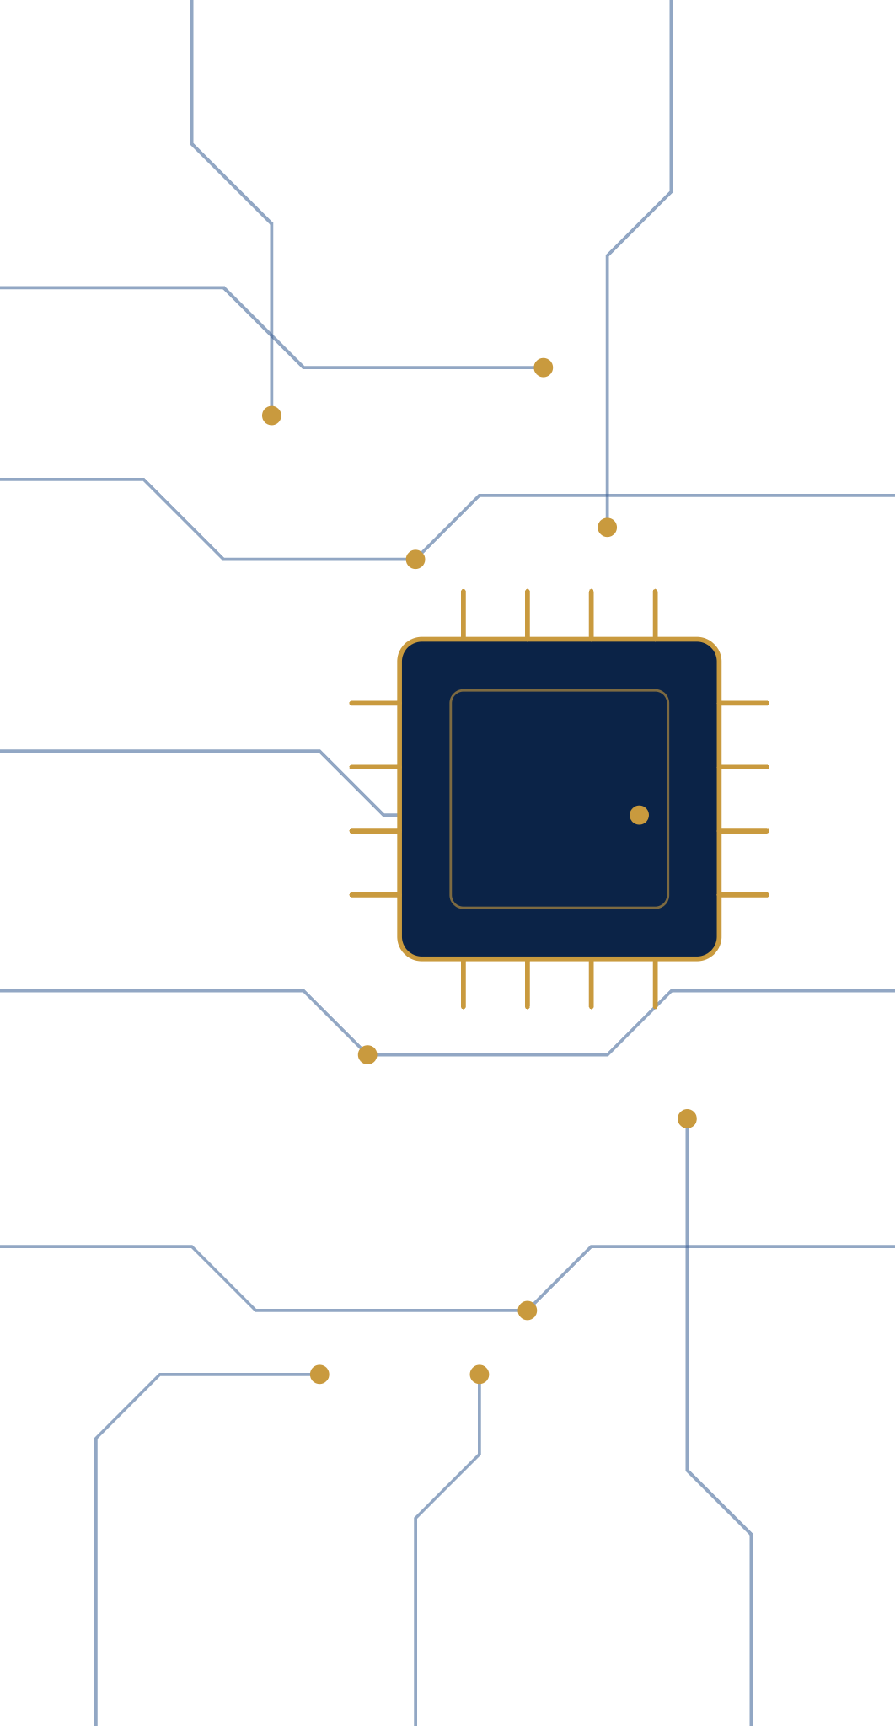


Introduction to gem5
Simulation Environment
PART I · COMPUTER ARCHITECTURE WITH GEM5
PRESENTED BY
Sagor Chandro Bakchy
PhD Student, Florida International University

Slide 6
Overview of gem5 simulator and capabilities
Outlines
Installation of Gem5 in local device
Simulation modes and configuration workflow
Running benchmarks and collecting statistics
Understanding simulation outputs (CPI, cache stats,
execution time)

Slide 7

Example

Slide 8
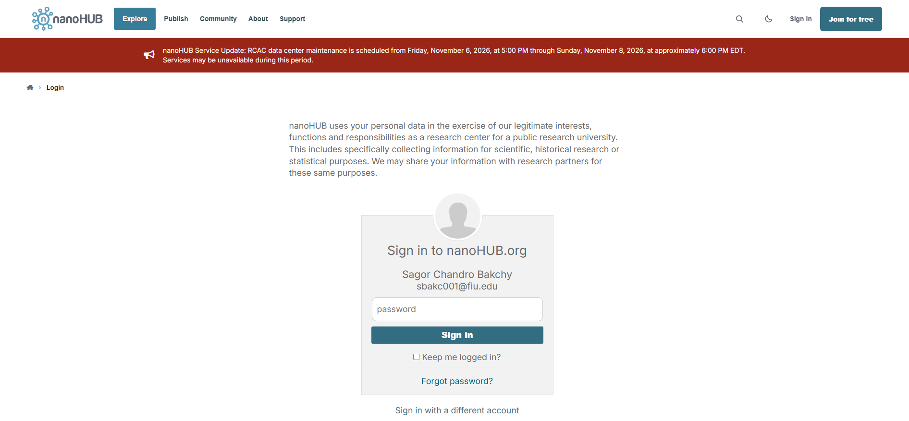
Accessing the Online Tool
1. Click the following link
https://nanohub.org/tools/scaleup/status
2. Login into your nanoHub account using your credentials

Slide 9
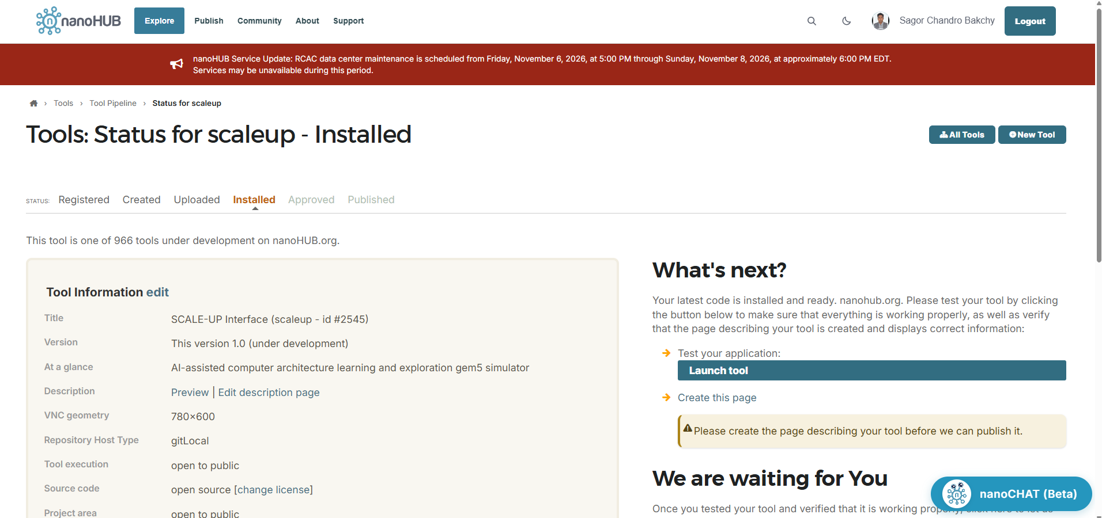
Accessing the Online Tool
3. After login successfully you will be redirected to the SCALE-UP status page
https://nanohub.org/tools/scaleup/status
4. Now click on the “Launch Tool” button

Slide 10
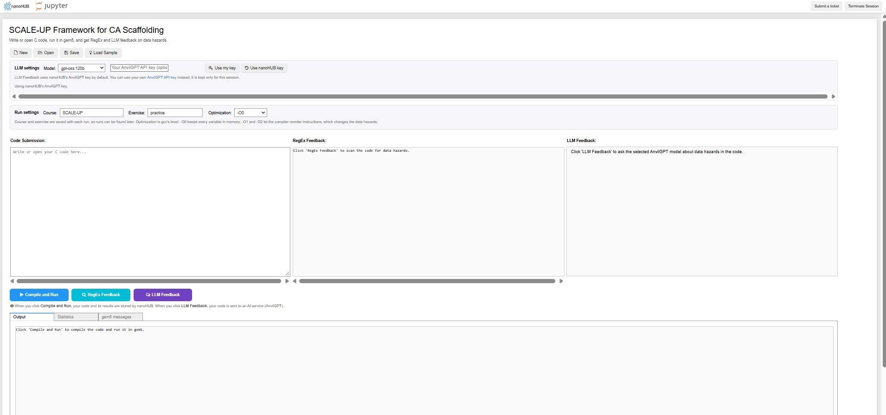
Accessing the Online Tool
5. Here you can see the SCALE-UP tool
6. You will have 3 boxes and 3 buttons
7. In the first box you will write your code or upload from your computer
8. First button will execute the code and show the output, second button shows the RegEx feedback and the third button shows the AI feedback
9. In the exercise field you can type the problem number (currently your name)

Slide 11
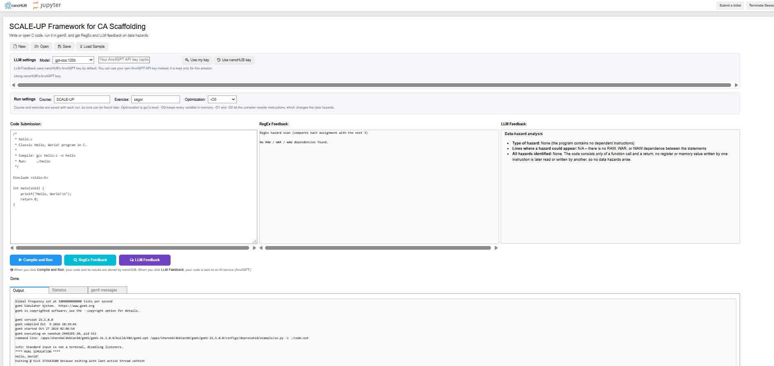
Accessing the Online Tool
10. One example code execution and corresponding output (Tool currently deals data hazard problem thus shows no hazard found)
https://drive.google.com/drive/folders/1quXM6t_31YEW_iLtmLaocz7PHEZ2zkT3?usp=sharing

Slide 12

What is Gem5 simulator?
Gem5: A full-system architecture simulator for computer architecture
study/research
🔬
Full-System Simulator
Simulates a complete computer system
CPU, memory, caches, I/O devices, and OS interactions in a single environment.
🏗
Modular Architecture
Highly modular design
Researchers work on CPU models, memory systems, and ISAs
📖
Open Source & Research
Developed by researchers worldwide
Supports ARM, x86, RISC-V, MIPS, SPARC, POWER and more

Slide 13

Why we need gem5 simulator over a real computer system?
Real Computer System
Cache sizes are fixed hardware
Memory types not adjustable
CPU speed can’t be changed
Same architecture in individual computer
Less controllable and observable
Acts as a black box
User sometimes have no ideas of original hardware impacts
Visibility of internal signals
Pipeline stalls cycle-by-cycle
Exact cache line movements
Microarchitectural events at instruction level
Fully controllable
CPU, RAM, cache and more are customizable
Gem 5 provides full customizable system
  Cache sizes (L1/L2/L3)
  Memory hierarchy timing
  Instruction set variations
  CPU types/speed

Slide 14
Gem5 installation steps
Requires “Linux” environment (OS)
Officially gem5 has been designed with a Linux environment
Ubuntu 22.04, Ubuntu 24.04 or latest to ensure gem5 functions well
Any Linux based OS should function if the correct dependencies are installed
Necessary dependencies (Gem5 official)
git: gem5 uses git for version control
gcc: gcc is used to compiled gem5. Version >=10 must be used
Clang: Clang also be used, support Clang 7 to Clang 16 (inclusive)
SCons: gem5 uses SCons as its build environment. SCons 3.0 or greater must be used
Python 3.6+: gem5 can be compiled and run in environments using Python 3.6+
protobuf 2.1+ (Optional): The protobuf library is used for trace generation and playback
Boost (Optional): The Boost library is a set of general-purpose C++ libraries

Slide 15
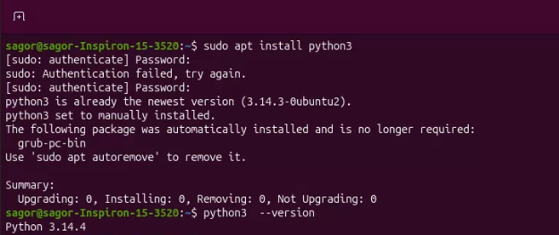
Gem5 installation steps
Installing “Python”
Open terminal in base directory (Ctrl + Alt + T) or click start and type terminal
Type the following command
sudo apt install python3
After the python is installed successfully check the installed version of python using
python3 --version
sudo: “superuser do” Runs command as administrator
(root). Required for system-level changes like installing
software.
apt: "Advanced Package Tool" The package manager
for Debian-based Linux systems (Ubuntu, Mint, etc.). It handles downloading, installing, and managing
software.
install: The subcommand telling apt what action to
perform. Other subcommands include remove, update,
upgrade, etc.
python3: The name of the package to install. This is the
Python 3 interpreter.

Slide 16
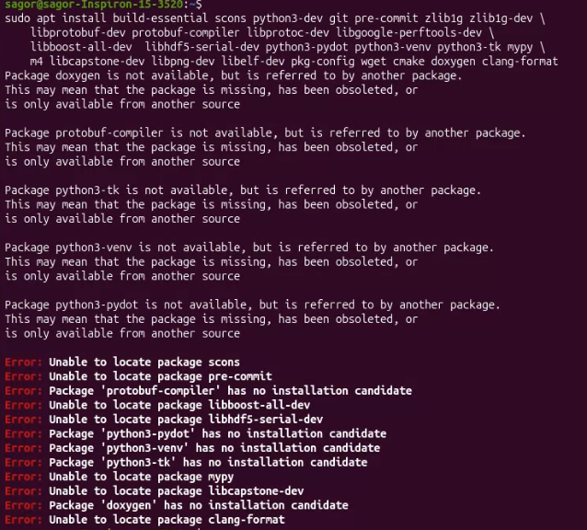
Gem5 installation steps
Installing dependencies
Following command from the terminal can install all the necessary dependencies in the system
sudo apt install build-essential scons python3-dev git pre-commit zlib1g zlib1g-dev libprotobuf-dev protobuf-compiler libprotoc-dev libgoogle-perftools-dev libboost-all-dev libhdf5-serial-dev python3-pydot python3-venv python3-tk mypy m4 libcapstone-dev libpng-dev libelf-dev pkg-config wget cmake doxygen clang-format
Running the command to install all the dependency
package may generate some errors
We proceed to install only the necessary dependencies one by one

Slide 17
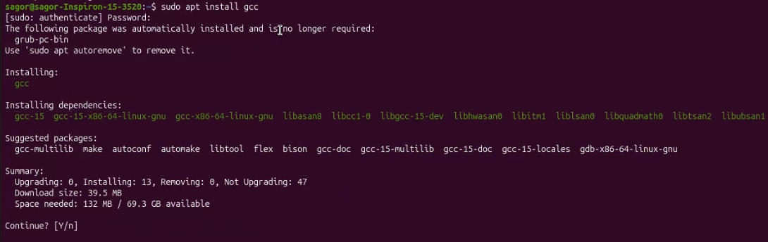
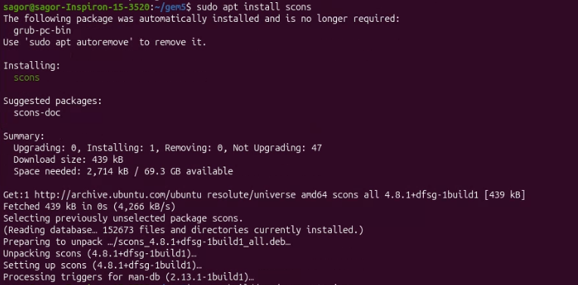
Gem5 installation steps
Installing “gcc” complier and “scons” for software building
gcc compiler package is necessary for code debugging in gem5. Following is the command
sudo apt install gcc
SCons is an open-source software construction tool
It is easier, reliable and faster way to build software using the following command
sudo apt install scons

Slide 18
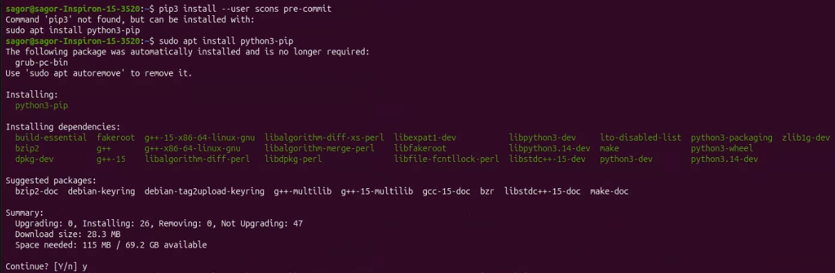
Gem5 installation steps
The “scons” requires “pre-commit” and “pip”
While install scons it requires pre-commit and pip. It depends on the system setting and status.
Depends on the induvial system. Following are the commands to install the packages
sudo apt install python3-pip
pip3 install –user scons pre-commit

Slide 19
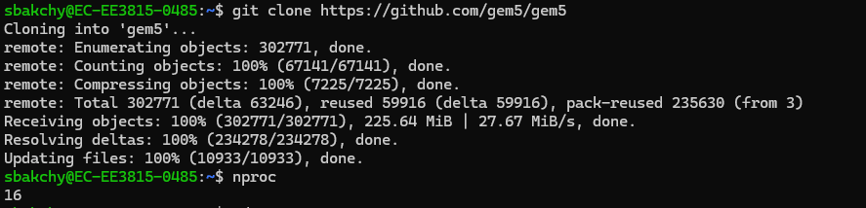

Gem5 installation steps
Copying the Gem5 in local computer from repository
Copying the repository from the github.com creates a folder “gem5” in the home directory in Ubuntu/Linux indicated in red circle in second image
Clone gem5 from github using:
git clone https://github.com/gem5/gem5

Slide 20
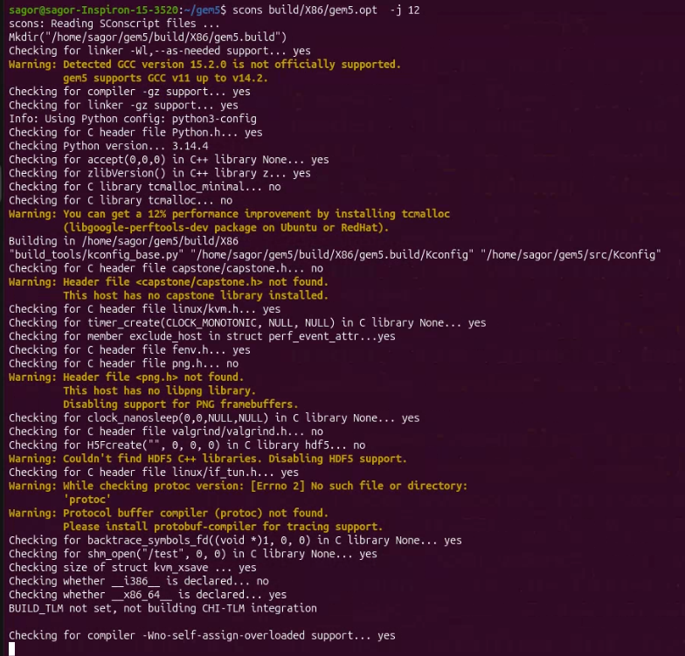
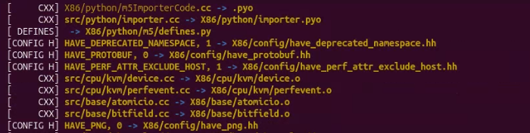

Gem5 installation steps
Install the X86 ISA in the system
We install the X86 instruction set architecture (ISA) in our system
scons build/X86/gem5.opt -j 12
ISA X86 installation takes a long time to install, may take 1 hour depending on system and network connectivity
Instruction explained
The basic command here is
scons build/{ISA}/gem5.{variant} -j {cpus}
{ISA}: includes ARM, NULL, MIPS, POWER, RISCV, SPARC, X86. Those
can be installed same the X86 ISA
{variant}: debug , opt and fast → Here we use opt and it has optimizations
turned on and debugging functionality
{cpus}: Specifies the number of CPU threads for compilation. To know your
CPU threads use nproc command in the terminal at root

Slide 21
Simulation modes and configuration workflow
Gem simulation modes
Full System (FS) Mode: simulates a complete hardware system. models everything including the CPU, memory, interrupts, exceptions, and I/O devices (like disk controllers and network interfaces)
Syscall Emulation (SE) Mode: a lighter, faster way to simulate. Compiled binary (like a C/C++ program), and gem5 runs the user-level instructions
Types of CPU in Gem5
AtomicSimpleCPU: Executes instructions atomically in a single cycle, used mainly for fast simulation and initialization
TimingSimpleCPU: Similar to AtomicSimpleCPU but models memory access timing, making it slower but more accurate
MinorCPU: An in-order pipeline CPU with a fixed 4-stage pipeline, offering a balance between performance and accuracy
O3CPU (Out-of-Order CPU): A detailed out-of-order superscalar CPU model, the most accurate but slowest to simulate
KvmCPU: Uses Linux KVM (Kernel-based Virtual Machine) to run simulations at near-native speed on real hardware
TraceCPU: Replays a pre-recorded execution trace to drive memory system simulation without re-executing instructions
DerivO3CPU: The default derived version of O3CPU used in most gem5 configurations, customizable via parameters

Slide 22
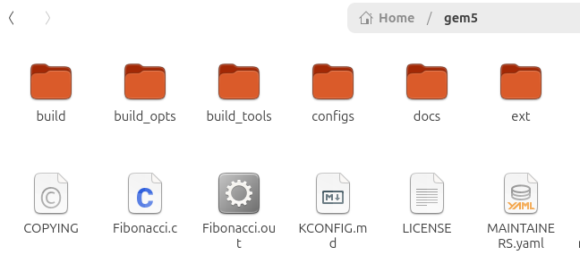
Code execution in Gem5
Writing code and preparing binary
We consider to write a C code for printing Fibonacci sequence (Fibonacci.c)
Write the code and save the code with “.c” using any text editor (notepad, document viewer, codeblock)
Prepare the binary from the code using the following command
gcc Fibonacci.c -o Fibonacci.out
The binary file is generated and stored in the same folder (directory)

Slide 23
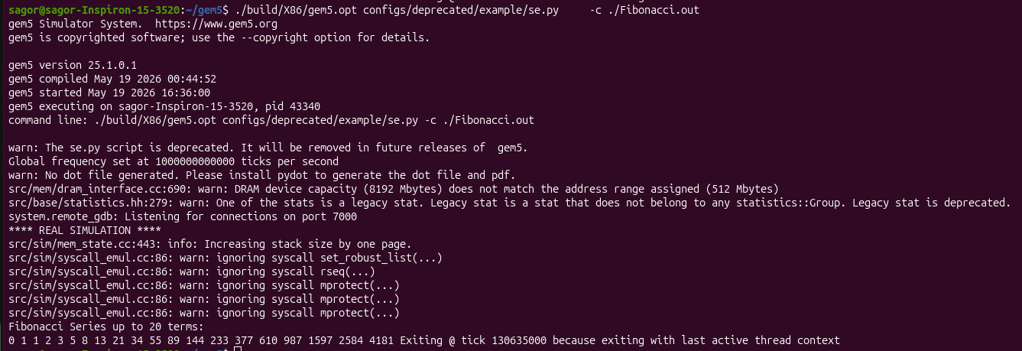
Code execution in Gem5
Executing “Fibonacci.out” in Gem5
The following command runs the binary file in Gem5 and prints the output
./build/X86/gem5.opt configs/deprecated/example/se.py -c ./Fibonacci.out
Output of the command is shown in the terminal

Slide 24
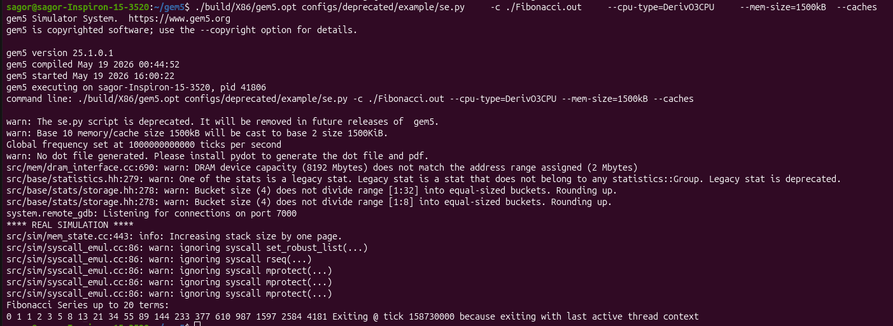
Code execution in Gem5
Configuring the CPU, RAM and cache
To customize the execution following command is used
./build/X86/gem5.opt configs/deprecated/example/se.py -c ./Fibonacci.out
--cpu-type=DeriveO3CPU --mem-size=1500kB --caches
Output of the command is shown in the terminal

Slide 25
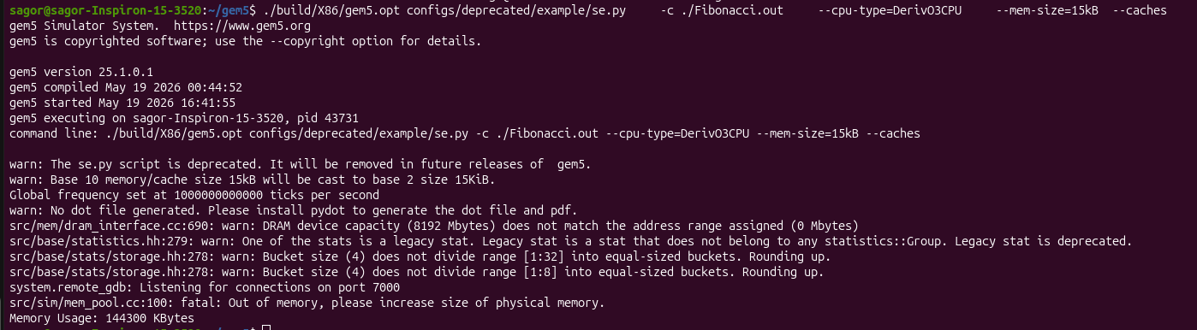
Code execution in Gem5
When RAM is insufficient
When customized RAM is not enough to run the code, it may produce a memory error
Here we set only 15kB of memory and a memory error is found

Slide 26
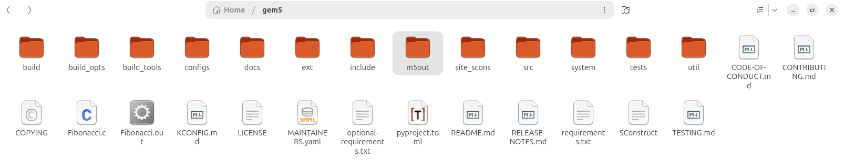
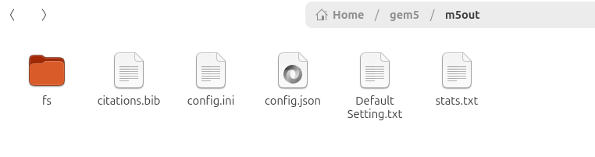
Running benchmarks and collecting statistics
While simulation is completed: Gem5 creates a folder “m5out” which contains information about system configuration and execution statistics

Slide 27
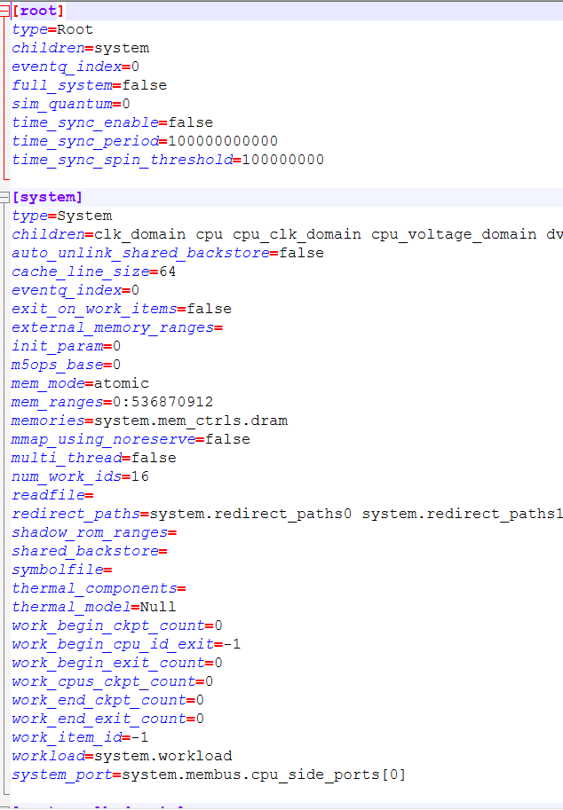
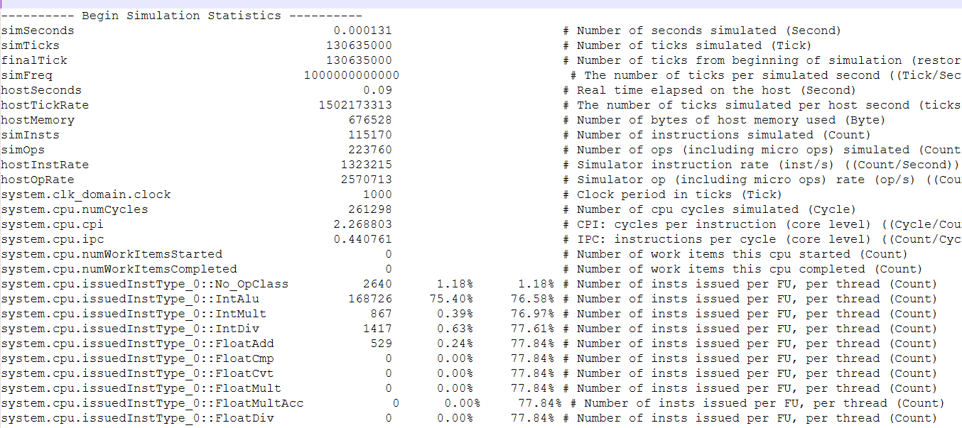
Running benchmarks and collecting statistics
The “m5out” includes: stats.txt, config.json and config.ini
Config file stores the system status and stats file stores the parameters of the system after execution of the code/instruction
Snap of the config file and stats file are shown below
configs.json
stats.txt

Slide 28
Understanding simulation outputs (CPI, cache stats, execution time)
After the “stats.txt” is obtained: parameter of each components are obtained
Individual entry in the stats.txt file are self explanatory. Looking at the red entry from the stats.txt file
---------- Begin Simulation Statistics ----------
simSeconds 0.000131 # Number of seconds simulated (Second)
simTicks 130635000 # Number of ticks simulated (Tick)
finalTick 130635000 # Number of ticks from beginning of simulation (restored from checkpoints and never reset) (Tick)
simFreq 1000000000000 # The number of ticks per simulated second ((Tick/Second))
hostSeconds 0.09 # Real time elapsed on the host (Second)
hostTickRate 1502173313 # The number of ticks simulated per host second (ticks/s) ((Tick/Second))
hostMemory 676528 # Number of bytes of host memory used (Byte)
simInsts 115170 # Number of instructions simulated (Count)
simOps 223760 # Number of ops (including micro ops) simulated (Count)
hostInstRate 1323215 # Simulator instruction rate (inst/s) ((Count/Second))
hostOpRate 2570713 # Simulator op (including micro ops) rate (op/s) ((Count/Second))
system.clk_domain.clock 1000 # Clock period in ticks (Tick)
system.cpu.numCycles 261298 # Number of cpu cycles simulated (Cycle)
system.cpu.cpi 2.268803 # CPI: cycles per instruction (core level) ((Cycle/Count))
system.cpu.ipc 0.440761 # IPC: instructions per cycle (core level) ((Count/Cycle))
simTick: 130635000 means total simulated clock cycle needed to execute the “Fibonacci.c” code in gem5
The text in the right after the (#) symbol indicates the meaning of the parameter
The CPI-Cycle per instruction, cache stats, execution time all are also explained in the stats file after the execution

Slide 29
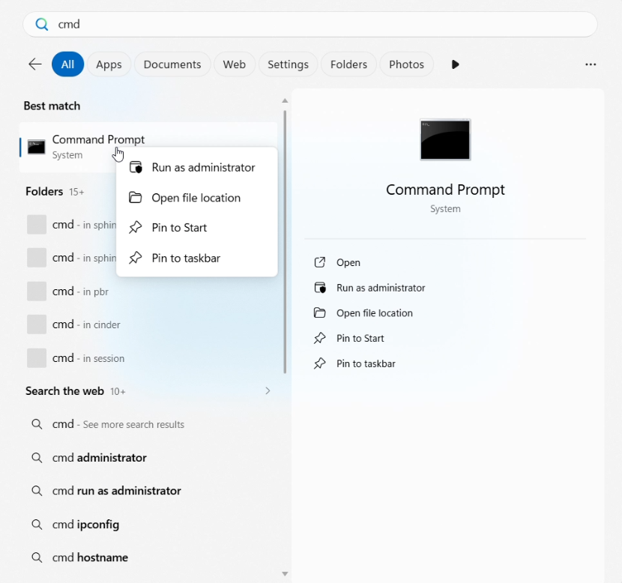
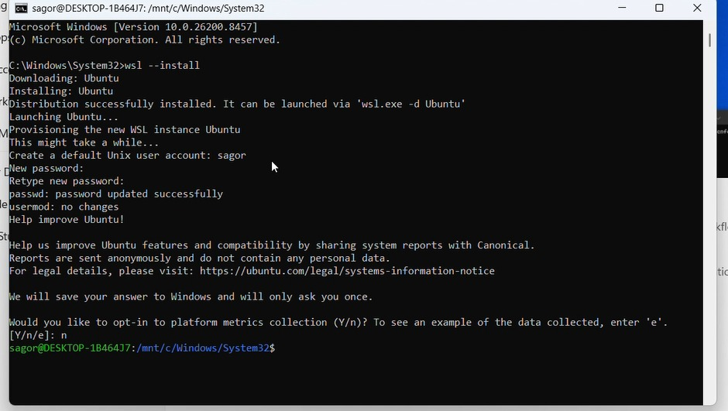
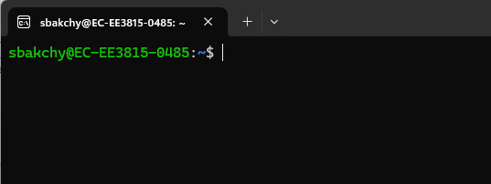
Gem5 installation: in Windows-11using windows subsystem for Linux 2 (WSL 2)
Installing WSL in Windows-11
From start menu search cmd and run as administrator
In cmd execute the following command to install wsl and creating a new account with user name and password
wsl --install
Again from the start menu search for “ubuntu app” and run it. It opens a terminal from the ubuntu OS

Slide 30
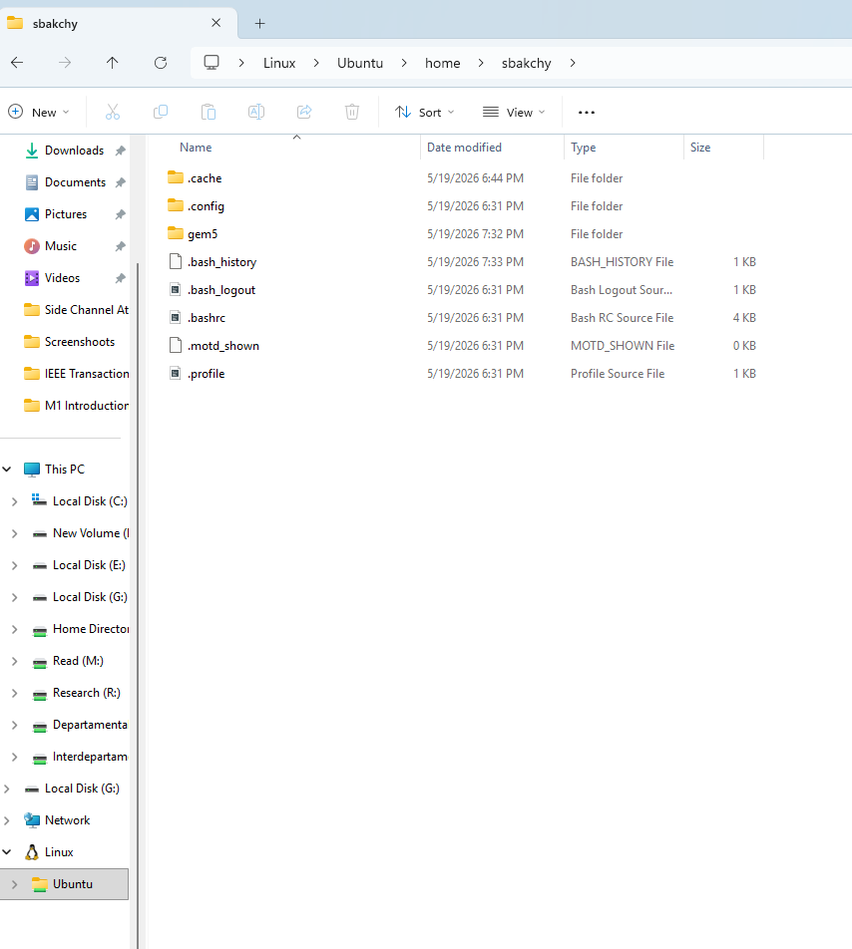
Gem5 installation: In Windows11using Windows Subsystem for Linux 2 (WSL 2)
Accessing Ubuntu OS
On starting the File Explorer: In the lower left a Linux icon is seen
Clicking there will take us to a complete ubuntu file system
There we find home directory, and user directory is also available
Inside the user directory we can install the gem5 simulator

Slide 31
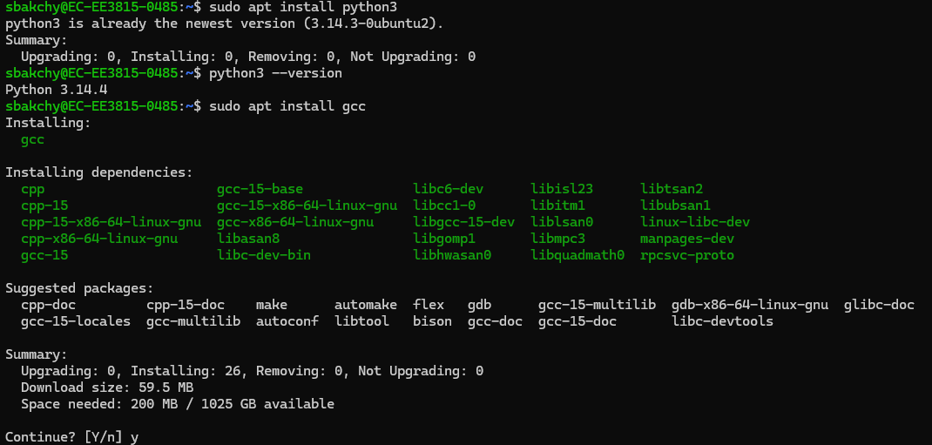
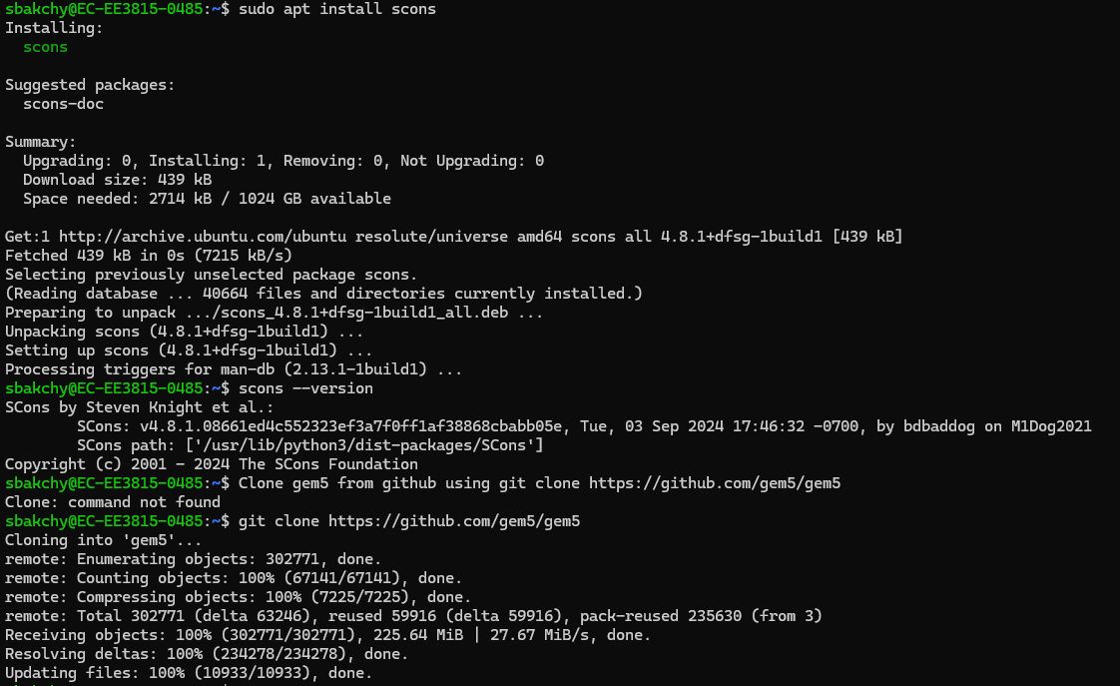
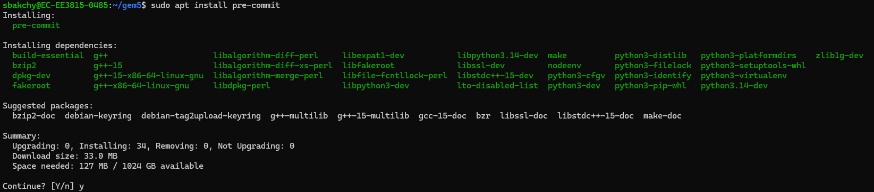
Installation and code execution in WSL2
All the steps are similar to original ubuntu platform as previous
Installing dependencies . If necessary, use sudo apt update to install scons

Slide 32
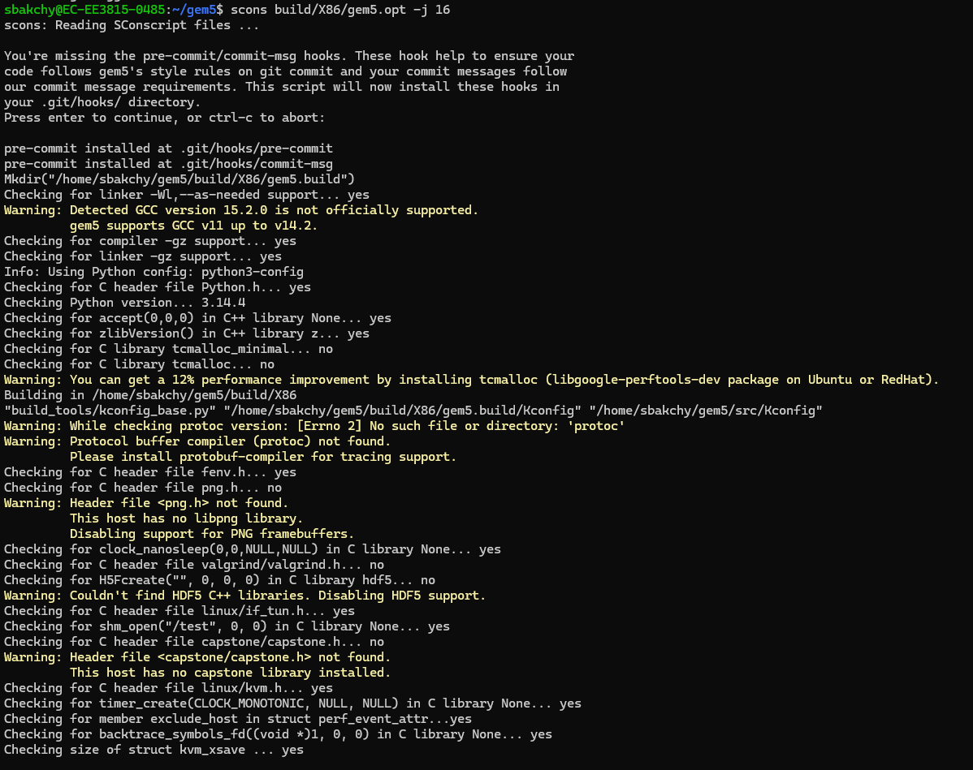
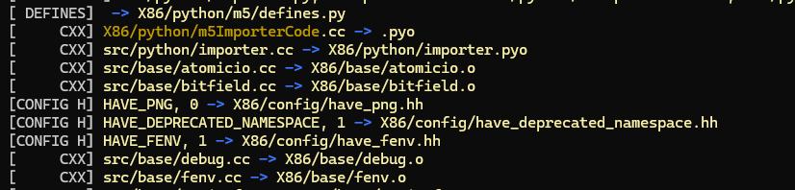
Installation and code execution in WSL2
All the steps are similar to original ubuntu platform as previous
Cloning gem5, installing scons and building X86 ISA

Slide 33
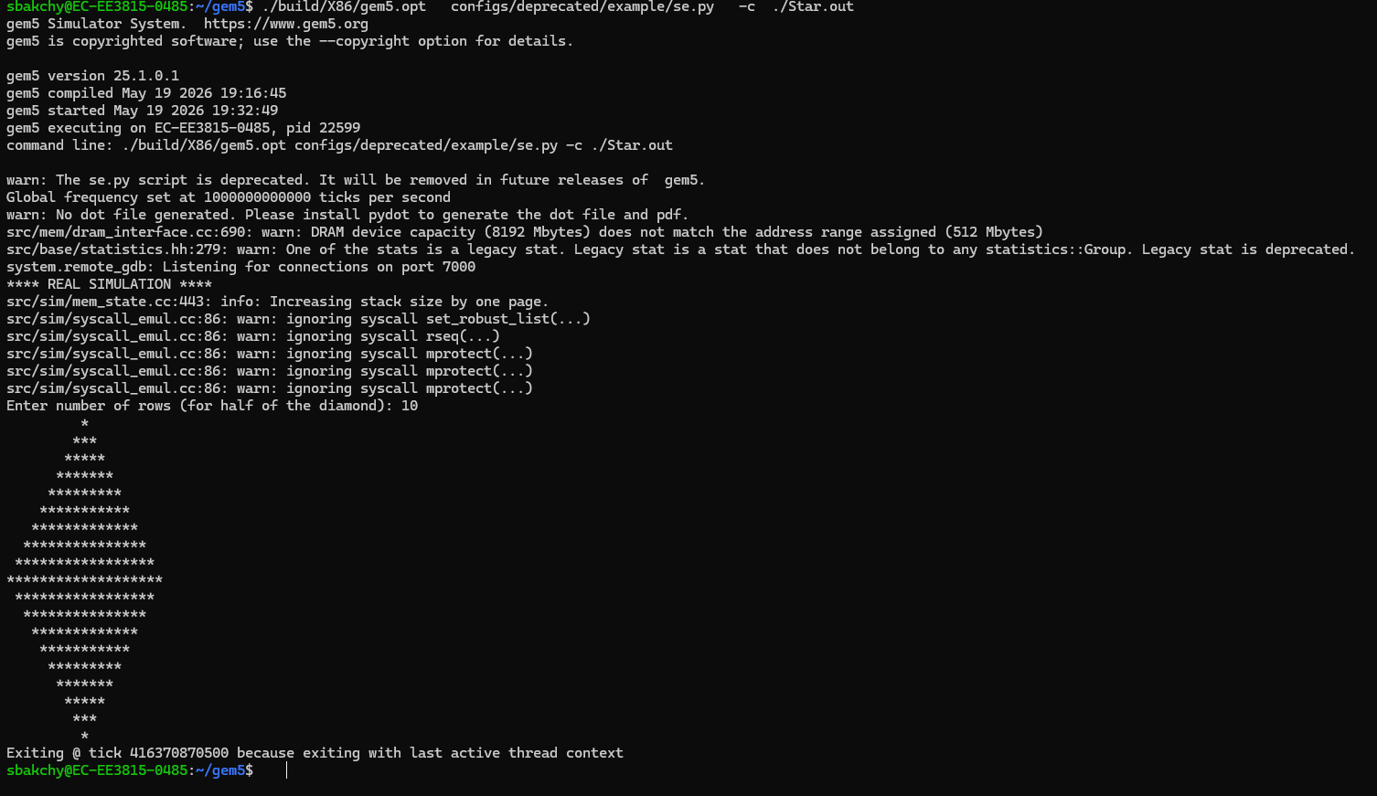

Installation and code execution in WSL2
All the steps are similar to original ubuntu platform as previous
Running a sample code in gem5 and the m5out contents

Slide 34
Gem5 installation: in macOS
Two ways to install gem5 on a Mac
Route A: Native build (Homebrew)
gem5 is compiled directly on macOS
Works on Intel and Apple Silicon (M1–M4)
Good for running gem5's ready-made test programs
Community-supported: gem5 is officially tested on Linux
Route B: Docker (recommended)
gem5 runs inside a small Ubuntu container
Same commands as the Ubuntu / WSL2 slides
Can compile your own C programs (e.g., Fibonacci.c) for gem5
Every student gets an identical environment
First, check which chip your Mac has
arm64 → Apple Silicon (M1, M2, M3, M4)
x86_64 → Intel processor
Terminal
$ uname -m
arm64
$ sw_vers -productVersion
15.1

Slide 35
Gem5 installation: in macOS (Route A: native)
Installing Xcode tools and “Homebrew”
Open Terminal: press Cmd + Space, type Terminal, press Enter
Install Apple's command line tools (gives clang, git, make)
xcode-select --install
Install Homebrew, the macOS package manager (paste the one-line command from brew.sh)
Apple Silicon only: add brew to your PATH with the two commands shown on the right
Check that everything is installed
Ubuntu: sudo apt install <pkg>
macOS: brew install <pkg>
Terminal
# 1. Apple command line tools
$ xcode-select --install
# 2. Homebrew (from brew.sh)
$ /bin/bash -c "$(curl -fsSL \
https://raw.githubusercontent.com/\
Homebrew/install/HEAD/install.sh)"
# 3. Apple Silicon only
$ echo 'eval "$(/opt/homebrew/bin/brew shellenv)"' >> ~/.zprofile
$ eval "$(/opt/homebrew/bin/brew shellenv)"
# 4. Verify
$ clang --version
$ git --version
$ brew --version

Slide 36
Gem5 installation: in macOS (Route A: native)
Installing dependencies with Homebrew
One command installs everything gem5 needs:
Terminal
$ brew install scons python protobuf gperftools hdf5 libpng boost m4 pkg-config
$ python3 --version ; scons --version
Ubuntu package (earlier slides) | Homebrew equivalent | Purpose
build-essential, gcc | xcode-select --install | C/C++ compiler (Apple clang)
scons | scons | Build tool for gem5
python3-dev | python | Python 3 with headers
libprotobuf-dev protobuf-compiler | protobuf | Trace generation (optional)
libgoogle-perftools-dev | gperftools | Faster memory allocator (optional)
libboost-all-dev / libhdf5-serial-dev | boost / hdf5 | C++ libraries / stats output (optional)
libpng-dev m4 pkg-config | libpng m4 pkg-config | Image, macro and build helpers

Slide 37
Gem5 installation: in macOS (Route A: native)
Cloning gem5 and building the X86 ISA
Terminal
The gem5 folder is created in your home folder (Finder → Go → Home)
nproc does not exist on macOS; use sysctl -n hw.ncpu to count CPU threads
Same build format as before:
scons build/{ISA}/gem5.{variant}
-j {cpus}
If SCons asks about installing git hooks, press Enter
Takes ~30–60 min depending on the Mac
$ cd ~
$ git clone https://github.com/gem5/gem5
$ cd gem5
$ sysctl -n hw.ncpu
8
$ scons build/X86/gem5.opt -j 8
If the build stops with errors
Run brew update && brew upgrade, then build again
Still failing? Switch to Route B (Docker); it avoids macOS compiler issues

Slide 38
Gem5 installation: in macOS (Route A: native)
Running the first simulation
Terminal
simple.py runs a ready-made “Hello world” program that comes with gem5
Output folder m5out (stats.txt, config.ini) appears inside the gem5 folder
$ build/X86/gem5.opt configs/learning_gem5/part1/simple.py
Beginning simulation!
Hello world!
Exiting @ tick 454646000 because exiting with last active thread context
Important limitation of the native route
gem5 (SE mode) can only run Linux programs
gcc Fibonacci.c -o Fibonacci.out on a Mac produces a macOS program that gem5 cannot load
To run your own C code, compile it inside Docker (Route B, next slides)
No KVM on macOS: KvmCPU is unavailable and full-system (FS) mode runs slowly

Slide 39
Gem5 installation: in macOS (Route B: Docker)
Installing Docker Desktop
Go to docker.com/products/docker-desktop
Download Docker Desktop for Mac: choose Apple Silicon or Intel chip (from uname -m)
Open the .dmg, drag Docker into Applications, launch it
Wait until the whale icon in the menu bar shows Engine running
Settings ⚙ → Resources: CPUs ≥ 4, Memory ≥ 8 GB, Disk ≥ 60 GB, then Apply & restart
Verify in Terminal with the commands on the right
Terminal
$ docker --version
Docker version 27.x
$ docker run hello-world
Hello from Docker!
macOS running in VMware?
Enable Virtualize Intel VT-x/EPT in VM settings
Check sysctl kern.hv_support prints 1

Slide 40
Gem5 installation: in macOS (Route B: Docker)
Starting the gem5 Ubuntu container
Terminal
$ mkdir -p ~/gem5-work
$ docker pull ghcr.io/gem5/ubuntu-24.04_all-dependencies:v24-0
$ docker run -it --name gem5 -v ~/gem5-work:/workspace -w /workspace \
ghcr.io/gem5/ubuntu-24.04_all-dependencies:v24-0
root@3f2a9c1d:/workspace#
Instruction explained
pull: downloads Ubuntu with all gem5 dependencies
-it: gives an interactive terminal
--name gem5: names the container for reuse
-v: Mac folder ~/gem5-work = /workspace in Ubuntu
After this command
The prompt changes to root@…:/workspace#: you are now inside Ubuntu
Leave: exit
Come back later: docker start -ai gem5

Slide 41
Gem5 installation: in macOS (Route B: Docker)
All the steps are similar to original Ubuntu platform as previous
root@gem5: /workspace
root@gem5: /workspace/gem5
# inside the container
$ git clone https://github.com/gem5/gem5
$ cd gem5
$ scons build/X86/gem5.opt -j 4
$ build/X86/gem5.opt \
configs/learning_gem5/part1/simple.py
# Apple Silicon: cross-compile for x86
$ apt update
$ apt install -y gcc-x86-64-linux-gnu
$ x86_64-linux-gnu-gcc -static \
Fibonacci.c -o Fibonacci.out
# Intel Mac: plain gcc -static works
Run Fibonacci.out in gem5
$ ./build/X86/gem5.opt configs/deprecated/example/se.py -c ./Fibonacci.out
Apple Silicon containers are ARM-based, so a plain gcc makes an ARM program; -static bundles the libraries gem5 needs
Results are visible on the Mac in ~/gem5-work/gem5/m5out (open with Finder or any editor)

Slide 42
Gem5 installation in macOS: troubleshooting
Common errors and fixes
Problem | Fix
Build stops with “Killed” during scons | Out of memory: use -j 2, or raise Docker Memory in Settings → Resources
“brew: command not found” (Apple Silicon) | Run the brew shellenv commands, then reopen Terminal
“Cannot connect to the Docker daemon” | Open Docker Desktop and wait for “Engine running”
gem5 cannot load my compiled program | It was built for macOS or ARM: compile in Docker with x86_64-linux-gnu-gcc -static
Docker very slow on Apple Silicon | Do not add --platform linux/amd64; use the default ARM image
Docker will not start inside a VMware macOS VM | Enable VT-x/EPT in VMware; check sysctl kern.hv_support = 1
“xcrun: error: invalid active developer path” | Run xcode-select --install again (common after macOS updates)

Slide 43
Thank you
98

Slide 44
Computer Architecture
with gem5
NEXT-GEN COMPUTING & HARDWARE SECURITY
CORE 0
CORE 1
L1
L1
Hands-on gem5 simulation with AI-guided learning
SHARED L3
Wednesday, Oct 28, 2026
IF
ID
EX
MEM
WB
CORE 2
CORE 3
IF
ID
EX
MEM
WB
L1
L1
10 AM – 2 PM ET
IF
ID
EX
MEM
WB
IF
ID
EX
MEM
WB
FIU EC3930 & on Zoom
IF
ID
EX
MEM
WB

Slide 45
Memory Hierarchy Design and Performance Analysis
PART II · COMPUTER ARCHITECTURE WITH GEM5
PRESENTED BY
Sagor Chandro Bakchy
PhD Student, Florida International University

Slide 46
1
Basic memory hierarchy and Cache fundamentals (L1, L2, LLC(L3))
2
Cache parameters: size, associativity, block size
Outlines
3
Replacement and write policies
4
Performance metrics: hit/miss rate, access latency, etc.
5
Memory bottlenecks in modern systems
6
Cache hierarchy code analysis in gem5 simulator

Slide 47
Basic Memory Hierarchy
Fastest
Smallest
Registers
bytes · < 1 ns
The core trade-off
Up the pyramid → faster, smaller, higher cost per bit
Down → larger capacity, lower cost, higher latency
L1 cache
64 KB · 1 ns
L2 cache
512 KB · 4 ns
Why it works: “locality”
Programs reuse recent data (temporal locality)
Access nearby addresses (spatial locality)
Keeping this “hot” data in the small, fast upper levels serves most accesses, so slow levels are hit only rarely.
L3 cache (LLC)
8-32 MB · 15 ns
Main memory (RAM)
GBs · 80 ns
Goal: the speed of the top with the capacity of the bottom
Secondary storage (SSD / HDD)
TBs · µs – ms
Largest
Cheapest

Slide 48
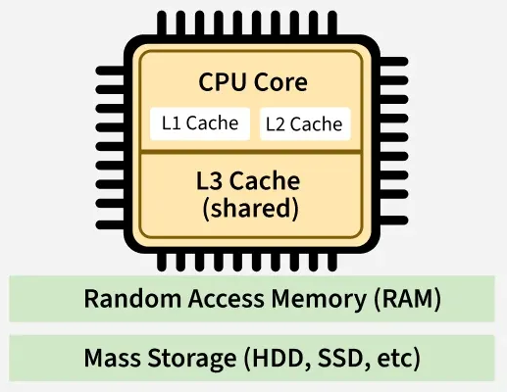
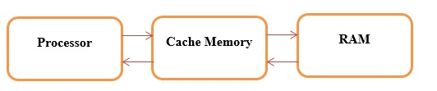
Cache Memory Fundamentals
Cache memory is a small, fast storage space within a computer
It holds duplicates of data from commonly accessed locations in the main memory
The CPU contains several separate caches that store both instructions and data.

Slide 49
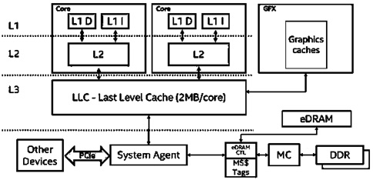
Types of Cache Memory
L1 Cache
1-4 Cycles Latency
CPU's most frequently accessed data resides in the L1 cache
Often split into separate instruction and data caches
First place the CPU looks at every access
L2 Cache
10-20 Cycles Latency
Level 2 cache is larger but slower than L1
L2 holds both instructions and data
Catches the misses on which L1 is too small to keep
L3/LLC Cache
30-50 Cycles Latency
LLC: Last Level Cache, slower than L1, L2, but big in size
Let cores share data quickly without hitting RAM/DRAM
A miss here means a slow trip to main memory making large latency

Slide 50
Cache Memory: Principle of Locality
Temporal Locality
Time-Based Reuse
          If a specific memory location is referenced, it will tend to be referenced again soon. Programs heavily reuse variables and tight execution loops.
Solution of Locality
Cache Implementation
          Caches effectively exploit locality by keeping recently used data active (temporal) and fetching entire blocks of data simultaneously (spatial).
Spatial Locality
Proximity-Based Reuse
If a memory location is referenced, adjacent locations will tend to be referenced soon. Instructions are sequential, and data structures (arrays) are contiguous.

Slide 51
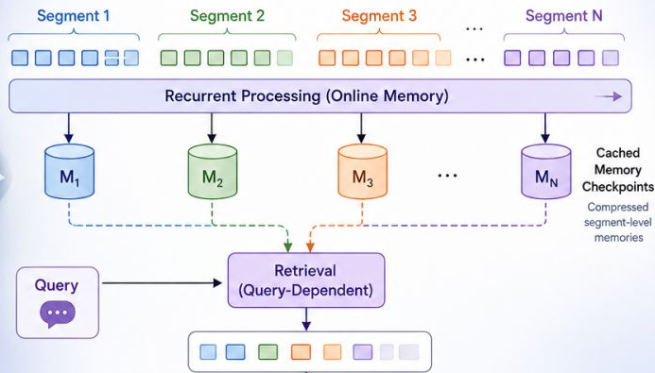
Cache Parameters: Size, Associativity, Block Size
Total Cache Size
          Indicated the total memory capacity. Larger caches mathematically lower overall miss rates but inherently increase hit time and silicon cost.
The exact size is calculated as:
$$Cache Capacity=\left(Block Size\right) x \left(Associativity\right) x (Number of Sets)$$
Block Size: The amount of data stored in a single cache block. It is measured in bytes.
Associativity: The number of cache blocks contained within each set. This is also called the associativity or the number of ways.
Number of Sets: The total number of sets into which the cache is divided.
Example:
Block Size = 64 Bytes
Blocks per Set (Associativity) = 4
Number of Sets = 256
$$Cache Capacity=64x4x256 \\ =256x256 \\ =65536 Bytes \\ =\frac{65536}{1024}=64 KB$$

Slide 52
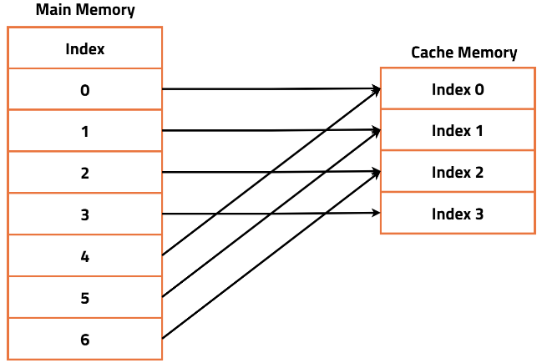
Cache Parameters: Size, Associativity, Block Size
Associativity (Blocks per Set)
          Indicates how mapping to sets is handled. Higher associativity drastically reduces conflict misses at the explicit cost of power and speed.
Associativity is calculated as:
$$A=\frac{C}{BxS}$$
A = Associativity (blocks per set or ways)
C = Cache Capacity (Bytes)
B = Block Size (Bytes)
S = Number of Sets
Example:
Cache Capacity (C) = 64 KB = 65,536 Bytes
Block Size (B) = 64 Bytes
Number of Sets (S) = 256
$$A=\frac{65536}{64x256} \\ A=\frac{65536}{16384} \\ A=4 KB$$

Slide 53
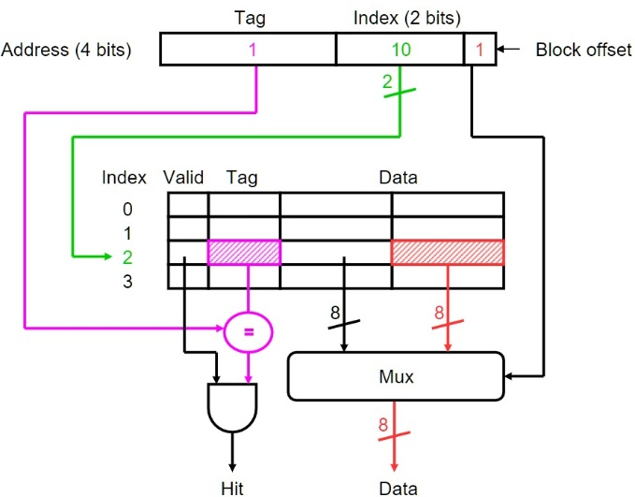
Cache Parameters: Size, Associativity, Block Size
Associativity is calculated as:
$$B=\frac{C}{AxS}$$
A = Associativity (blocks per set or ways)
C = Cache Capacity (Bytes)
B = Block Size (Bytes)
S = Number of Sets
Block (Line) Size
          The fundamental unit of data transfer (e.g., 64 bytes). It increases spatial locality benefits but risks cache pollution if set too large.
Example:
Cache Capacity (C) = 64 KB = 65,536 Bytes
Associativity (A) = 4
Number of Sets (S) = 256
$$B=\frac{65536}{4x256} \\ B=\frac{65536}{1024} \\ B=64 Bytes$$

Slide 54
Replacement Policies
A replacement policy determines which cache block to remove (evict) when a new block needs to be loaded into a full cache set.
1. Least Recently Used (LRU)
2. First-In, First-Out (FIFO)
3. Least Frequently Used (LFU)
Replaces the block that has not been accessed for the longest time.
High cache hit rate, exploits temporal locality.
Requires additional hardware and tracking overhead.
Replaces the block that has been in the cache the longest.
Simple and low hardware cost.
May remove frequently used blocks.
Replaces the block with the fewest accesses.
Retains frequently used data.
Requires access counters and additional hardware.

Slide 55
Replacement Policies
4. Pseudo-LRU (PLRU)
5. Random Replacement
Approximates LRU using fewer hardware bits.
Lower hardware complexity than LRU with good performance.
Slightly less accurate than true LRU.
Randomly selects a block for replacement.
Very simple and low overhead.
Unpredictable performance may evict useful data.

Slide 56
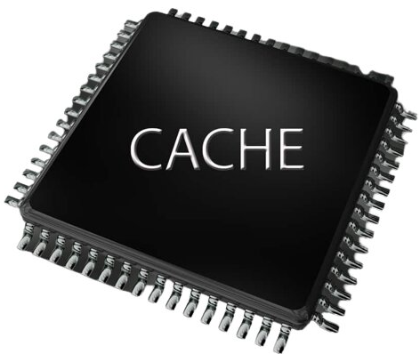
Write Policies
A write policy determines how write operations are handled between the cache and the main memory.
Write-Through
Updates both the cache and the main memory simultaneously
Main memory is always up to date. Simpler data consistency.
Higher memory traffic and slower write performance.
Write data on cache and RAM
after each instruction execution
Write-Back
  CPU updates only the cache
  Fewer memory writes make faster write performance.
  More complex hardware and has risk of losing modified data
56

Slide 57
Performance Metrics
How much does the memory system slow the processor down for every access?
Which parameters are responsible for the slowdown?
1. Hit Rate and Miss Rate
2. Hit Time (Access Latency)
Hit rate is the fraction of accesses that find their data in the cache, miss rate is its complement, so hit rate + miss rate = 1.
A high hit rate can be deceptive on its own, a 95% hit rate still means 5% of accesses are misses, and if each miss is very expensive, those misses can dominate total access time.
Miss rate must always be paired with miss penalty, neither is meaningful alone.
A reported miss rate summarizes the combined effect of workload locality and cache organization.
The time to deliver data when an access hits, the latency of the fast, common-case path.
Paid on nearly every access, so it directly gates the processor's clock and pipeline.
Creates a core tension: larger or more associative caches lower miss rate but raise hit time, because bigger structures are slower to index and compare.
A small fast L1 optimized for low hit time, backed by larger slower L2/L3 optimized for low miss rate.
57

Slide 58
Performance Metrics
3. Cache Transfer / Bandwidth
4. Miss Penalty
Latency describes when the first bytes arrive; transfer time and bandwidth describe how fast an entire block moves once transfer begins.
Miss penalty is partly fixed latency (overhead to start the access) and partly transfer time.
Larger blocks amortize fixed latency over more bytes and exploit spatial locality, but lengthen transfer time and consume more bandwidth.
On a shared bus with multiple cores, bandwidth not latency is often the real bottleneck; a cache that lowers miss rate but moves large blocks can still saturate the bus.
The extra time to service a miss: detecting it, requesting from the next level, transferring the block back, and delivering the word.
Usually, the largest latency an L1 hit may be a few cycles, while a main-memory miss can be hundreds.
Not a single fixed value in a multi-level hierarchy: an L1 miss that hits in L2 has a small penalty; one that reaches DRAM has a large one.
This recursive structure is what makes hierarchical (level-by-level) analysis necessary.
58

Slide 59
Performance Metrics
5. Average Memory Access Time (AMAT)
6. CPU Time / Memory Stall Cycles
$AMAT=Hit time+Miss rate x Miss penalty$
Shows hit time is always paid, while the miss penalty is paid only on the miss-rate fraction of accesses.
The antidote to the "95% hit rate sounds great" trap, because it forces the miss rate and the miss penalty to be multiplied together.
$CPU time=\left(CPU execution cycles+Memory stall cycles\right) x Clock cycle time$
Shows that lowering AMAT (adding associativity) only helps if the miss-rate reduction outweighs any hit-time increase.
A cache improvement matters more on memory-bound workloads than compute-bound ones.
59

Slide 60
Memory Bottlenecks in Modern Systems
Processor speed grows far faster than RAM, it is making memory the limiting resource.
Latency improves slowly, while bandwidth improves faster.
Caching, prefetching, out-of-order execution, and multithreading overlap memory access.
Effective workloads hit the bandwidth ceiling, leaving ALUs idle.
Fetching an operand from DRAM costs one to two orders, making memory an issue.
60

Slide 61
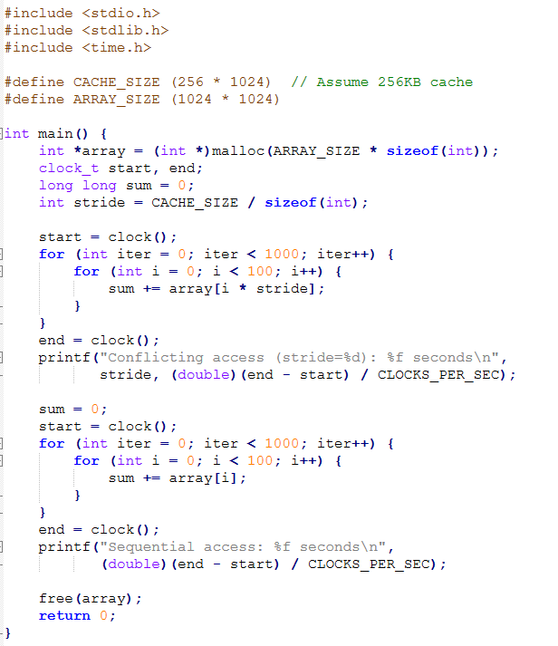
Memory Conflict Code Execution in gem5
We will execute the following code to observe the cache behaviors
Possible reasons for getting an error while running the code
CACHE_SIZE = 256 KB
It is an incorrect assumption about cache size
Default gem5 configurations
CPU: AtomicSimpleCPU
Number of CPUs: 1
Memory Size: 512 MB
L1 and L2 Cache: Disabled
L3 Cache: Not available
Cache Line Size: 64 Bytes
Main Memory: DDR3
Cache size = 256 KB
int = 4 bytes
So, stride = 256 KB / 4
= 262144 / 4
= 65536
Every access is exactly one cache size apart
for(int i=0;i<100;i++)
sum += array[i*stride];
Demonstrates spatial locality

Slide 62
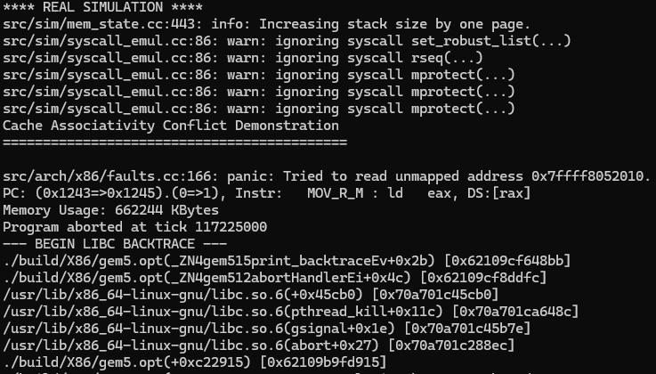
Memory Conflict Code Execution in gem5
We have used WSL in Windows to execute code in gem5
The conflicted code stops execution, showing an error

Slide 63
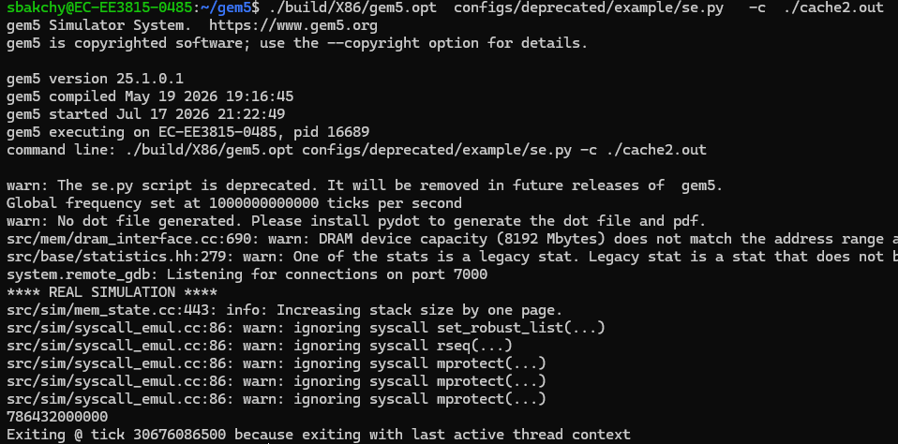
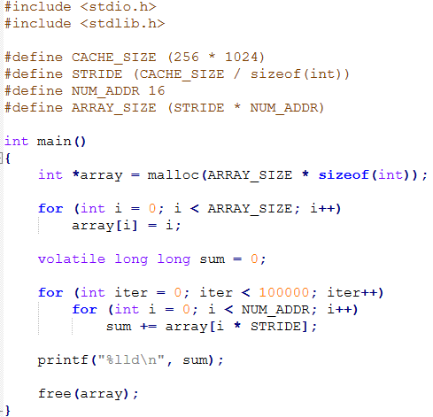
Memory Conflict Code Execution in gem5
Modifying the code makes it conflict-free, and the code runs successfully
**The cache size and stride for integers have been addressed in the code.

Slide 64
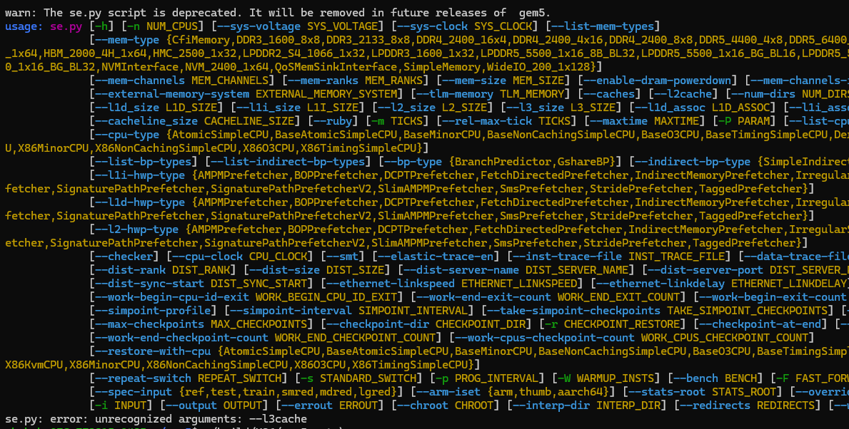
Memory Conflict Code Execution in gem5
Customized cache for execution
./build/X86/gem5.opt configs/deprecated/example/se.py -c ./cache.out --mem-size=1GB --caches --l2cache --l1i_size=32kB --l1d_size=32kB --l1i_assoc=8 --l1d_assoc=8 --l2_size=256kB --l2_assoc=8 --l3_size=8MB --l3_assoc=16
Still found an issue as the defined CPU doesn’t support L3 cache

Slide 65
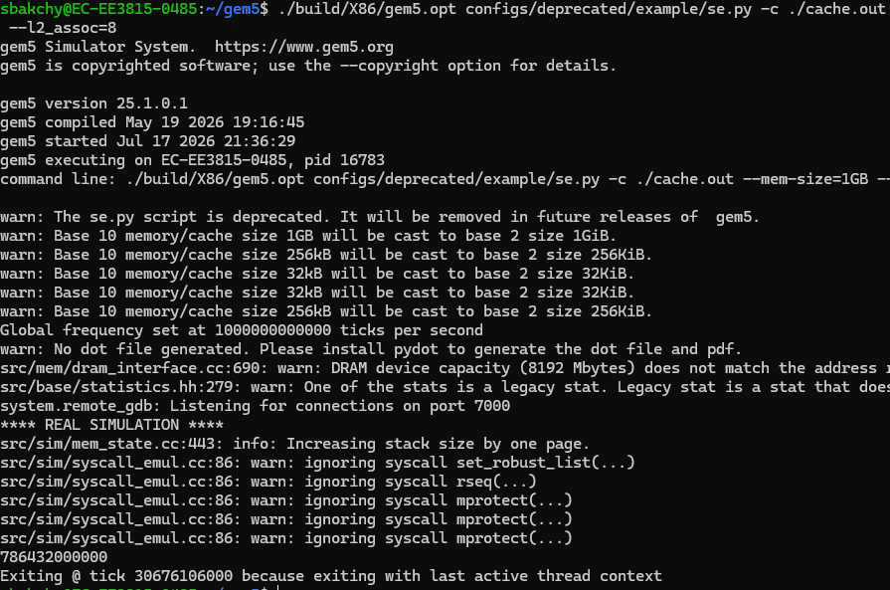
Memory Conflict Code Execution in gem5
Customized cache for execution with L1 and L2 cache and 1GB of RAM
./build/X86/gem5.opt configs/deprecated/example/se.py -c ./cache.out --mem-size=1GB --caches --l2cache --l1i_size=32kB --l1d_size=32kB --l1i_assoc=8 --l1d_assoc=8 --l2_size=256kB --l2_assoc=

Slide 66
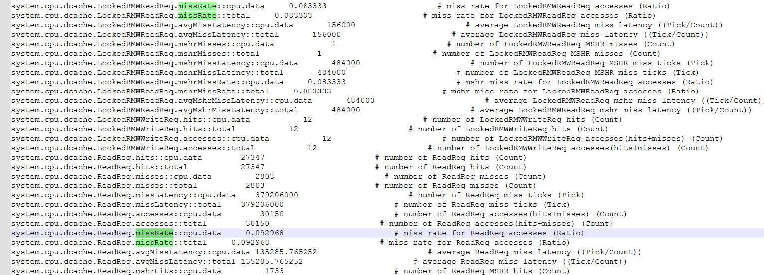
Memory Conflict Code Execution in gem5
Cache performance metrics can now be accessed from the stats file generated in gem5. A snap of the “stats.txt” file is shown here

Slide 67
Memory Conflict Code Execution in gem5
The first code was not executing due to more than the available memory
We can modify the code to run in the non-customized system
Also, the system configuration can be modified to complete the code to produce output
Along with memory, the CPU can be changed to avoid memory conflicts

Slide 68
Thank you
98

Slide 69
Computer Architecture
with gem5
NEXT-GEN COMPUTING & HARDWARE SECURITY
CORE 0
CORE 1
L1
L1
Hands-on gem5 simulation with AI-guided learning
SHARED L3
Wednesday, Oct 28, 2026
IF
ID
EX
MEM
WB
CORE 2
CORE 3
IF
ID
EX
MEM
WB
L1
L1
10 AM – 2 PM ET
IF
ID
EX
MEM
WB
IF
ID
EX
MEM
WB
FIU EC3930 & on Zoom
IF
ID
EX
MEM
WB

Slide 70
Pipeline Design and Hazard Analysis
PART III · COMPUTER ARCHITECTURE WITH GEM5
PRESENTED BY
Sagor Chandro Bakchy
PhD Student, Florida International University

Slide 71
1
Pipeline stages and instruction flow
Outlines
2
Types of hazards: control hazard, structural hazard, and data hazard
3
Data hazards in detail: RAW, WAR, WAW
4
Hazard mitigation: forwarding, stalling
5
Pipeline hazard analysis in the gem5 simulator

Slide 72
What Is Pipelining?
The idea of pipeline
Example of laundry operation
Split instruction execution into k independent stages, each with its own hardware.
Once stage 1 finishes an instruction, it starts the next one instead of waiting.
Latency of a single instruction does not improve. Throughput does: one instruction completes per cycle in steady state.
Four loads of laundry: wash, dry, fold, put away.
Do them one load at a time and you wait for the dryer while the washer sits idle.
Start washing load 2 the moment load 1 moves to the dryer and every machine stays busy.
A pipeline is a processor that keeps all its machines busy.
Four stages of laundry operation
t1
t2
t3
t4
t5
t6
t7
Load 1
Wash
Dry
Fold
Store
Load 2
Wash
Dry
Fold
Store
Load 3
Wash
Dry
Fold
Store
Load 4
Wash
Dry
Fold
Store
Sequentially, this takes 16 time slots. Overlapped, it takes 7.

Slide 73
The Five Pipeline Stages
IF
Instruction Fetch
ID
Instruction Decode
EX
Execute
MEM
Memory Access
WB
Write Back
Read the instruction at the PC from instruction memory / instruction-cache.
Increment PC (or take the predicted target).
Decode the opcode and generate control signals.
Read source operands from the register file
ALU performs arithmetic, logic, or shift.
Computes effective address for loads/stores and the branch condition.
Loads read from the D-cache and stores write to it.
Non-memory instructions pass straight through.
Write the ALU result or loaded value into the destination register/memory.
The instruction is now architecturally complete.
Pipeline registers hold the state
At each clock edge, every stage's results and control signals are captured into the next latch.
Lets five instructions occupy the datapath at once without overwriting each other.
Forwarding paths tap these latches directly.
Clock period is set by the slowest stage
T_clock = max(stage delay) + latch overhead, not the average stage delay.
One slow stage caps the whole design, so balancing stages matters as much as adding them.
Deeper pipelines shorten T_clock but raise the branch misprediction penalty.

Slide 74
Sequential vs. Pipelined Execution
Non-pipelined: 3 instructions x 5 stages = 15 cycles
IF
ID
EX
MEM
WB
IF
ID
EX
MEM
WB
IF
ID
EX
MEM
WB
Total Time=15
I1
I2
I3
Pipelined: the same 3 instructions finish in 7 cycles
1
2
3
4
5
6
7
I1
IF
ID
EX
MEM
WB
I2
IF
ID
EX
MEM
WB
I3
IF
ID
EX
MEM
WB
Total Time=7
Understanding the example
Cycles 1-4 are the fill: the pipeline is not yet full, so some stages are idle. Cycles after the last IF are the drain.
Steady state begins in cycle 5, where all five stages hold a different instruction and one instruction retires per cycle.
Fill and drain cost (k - 1 = 4) cycles once per program.

Slide 75
Instruction Flow Through the Pipeline
C1
C2
C3
C4
C5
C6
C7
C8
C9
I1
IF
ID
EX
MEM
WB
I2
IF
ID
EX
MEM
WB
I3
IF
ID
EX
MEM
WB
I4
IF
ID
EX
MEM
WB
I5
IF
ID
EX
MEM
WB
Cycle 5: pipeline full
What the diagram presents:
      Total cycles for n instructions with k stages, with no hazards: k + n - 1. Here 5 + 5 - 1 = 9.
Every column is a snapshot of the hardware; every row is the life of one instruction.
A hazard shows up as a repeated or blank cell in a row, which is exactly what the next sections analyse.

Slide 76
Types of Pipeline
1
2
3
4
5
6
7
I1
IF
ID
EX
MEM
WB
Linear Pipeline
(One stage overlaps)
I2
IF
ID
EX
MEM
WB
I3
IF
ID
EX
MEM
WB
1
2
3
4
5
6
7
I1
IF
ID
EX
MEM
WB
Scalar Pipeline
(Half of stage time overlaps)
I2
IF
ID
EX
MEM
WB
I3
IF
ID
EX
MEM
WB
1
2
3
4
5
6
7
I1
IF
ID
EX
MEM
WB
Super Scalar Pipeline
(Multiple stage overlaps)
I2
IF
ID
EX
MEM
WB
I3
IF
ID
EX
MEM
WB
I4
IF
ID
EX
MEM
WB

Slide 77
Hazards in Pipeline Execution
A hazard is any condition that prevents the next instruction from starting in its intended cycle.
Control Hazards
Structural Hazards
Data Hazards
The pipeline must fetch the next instruction before it knows whether a branch is taken.
Also called branch hazards. Caused by branches, jumps, calls, returns, and exceptions.
Cost grows with pipeline depth, since more wrong instructions are in flight.
Fixed by prediction, early branch resolution, and delayed branches.
Two instructions need the same hardware resource in the same cycle.
Classic case: a single unified memory serving IF and MEM simultaneously.
Also arises from a single register-file write port or a non-pipelined divider.
Fixed by duplicating or pipelining the resource, otherwise by stalling.
An instruction needs an operand that an earlier, still in-flight instruction has not produced yet.
Three kinds by dependence type: RAW, WAR, WAW.
RAW is the only one that appears in a simple in-order 5-stage pipeline.
Fixed by forwarding, and by stalling when forwarding is not enough.

Slide 78
Control Hazards
The pipeline must fetch instruction i + 1 before it knows the outcome of a branch at instruction i.
C1
C2
C3
C4
C5
C6
C7
C8
beq (branch)
IF
ID
EX
MEM
WB
next + 1
IF
ID
flushed
next + 2
IF
ID
flushed
target
IF
ID
EX
MEM
WB
branch resolved in EX (C3)
A superscalar core fetching 4 per cycle discards 4 x penalty instructions.
This is why prediction accuracy, not raw depth, limits modern front-end design.
It explains the industry retreat from very deep pipelines.

Slide 79
Structural Hazards
I4's fetch collides with I1's data access in cycle 4. Tries to access same hardware
C1
C2
C3
C4
C5
C6
C7
C8
I1
IF
ID
EX
MEM
WB
I2
IF
ID
EX
MEM
WB
I3
IF
ID
EX
MEM
WB
I4
IF
ID
EX
MEM
WB
If access the same memory in C4
One memory port shared by IF and MEM.
A single write port on the register file when two instructions retire together.
A non-pipelined unit, such as an integer divider that occupies EX for many cycles.
A shared bus between cores or between the core and the cache.

Slide 80
Data Hazard: Read After Write (RAW) Hazard
add x1, x2, x3 # writes x1
sub x4, x1, x5 # reads x1
What RAW means
Reads a register before it has been written it back.
It is a true dependence, imposed by the algorithm itself. It cannot be renamed away, only tolerated.
In the 5-stage pipeline the producer writes in WB (cycle 5) but the consumer reads in ID (cycle 3).
Left unhandled, the consumer silently reads the stale value. This is a correctness bug, not just a slowdown.
Here x1 is a variable that written in C5
C1
C2
C3
C4
C5
C6
add
IF
ID
EX
MEM
WB
sub
IF
ID
EX
MEM
WB
x1 needed in C3 for sub operation which is saved in C5 of add operation ->
2-cycle gap

Slide 81
Data Hazard: WAR and WAW Hazard
WAR: Write After Read Hazard
WAW: Write After Write Hazard
A later instruction writes a register that an earlier instruction has not read yet.
Cannot occur in the in-order 5-stage pipeline: reads happen in ID, writes in WB, and ID always precedes WB in program order.
Appears with out-of-order issue, or when an instruction reads a register late in a long pipeline.
Two instructions write the same register and the writes complete out of program order, leaving the wrong final value.
Cannot occur when every instruction writes in the same stage (WB) in order.
Appears when write latencies differ, for example a multi-cycle FP multiply followed by a single-cycle integer add.
sub x4, x1, x3 # reads x1
add x1, x2, x5 # writes x1
fmul x1, x2, x3 # writes x1 after 5 cycles
add x1, x4, x5 # writes x1 after 1 cycle

Slide 82
Hazard Mitigation with Forwarding
The result exists at the end of EX, in the EX/MEM latch. It is simply not in the register file yet.
Add multiplexers on the ALU inputs that can select the EX/MEM or MEM/WB latch instead of the register-file output.
A forwarding unit compares the destination register of in-flight instructions against the source registers in EX.
Cost: two multiplexers, a comparator network, and extra wiring. No stall cycles.
C1
C2
C3
C4
C5
C6
add
IF
ID
EX
MEM
WB
sub
IF
ID
EX
MEM
WB
result forwarded, zero stalls
Forwarding removes almost every RAW stall

Slide 83
Hazard Mitigation with Stalling
C1
C2
C3
C4
C5
C6
C7
C8
IF
ID
EX
MEM
WB
IF
ID
bubble
EX
MEM
WB
IF
stall
ID
EX
MEM
WB
A hazard detection unit in ID compares the source registers of the instruction in ID against the destination of the load in EX.
On a match it does three things in the same cycle:
  Hold the PC so IF refetches the same instruction,
  Hold the IF/ID latch so ID re-decodes,
  Zero the control signals in ID/EX, creating a NOP that flows harmlessly down the pipe.
That zeroed slot is the bubble. It occupies a stage but does no useful work.

Slide 84
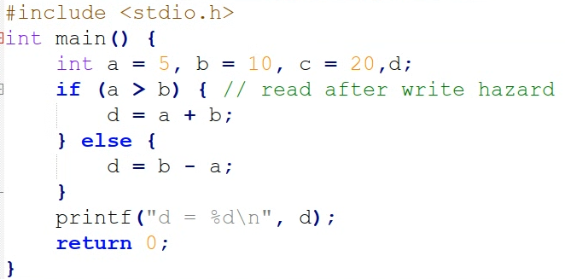
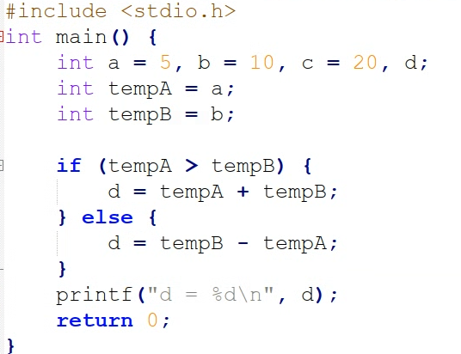
Hazard Observation in “C” Code
Code without data hazard
Code consisting of data hazard
Hazard and NoHazard code
First code (Hazard.c) and second (NoHazard.c) producing the same output
Second code is modified with a temporary variable
This code modification does not handle data hazard

Slide 85
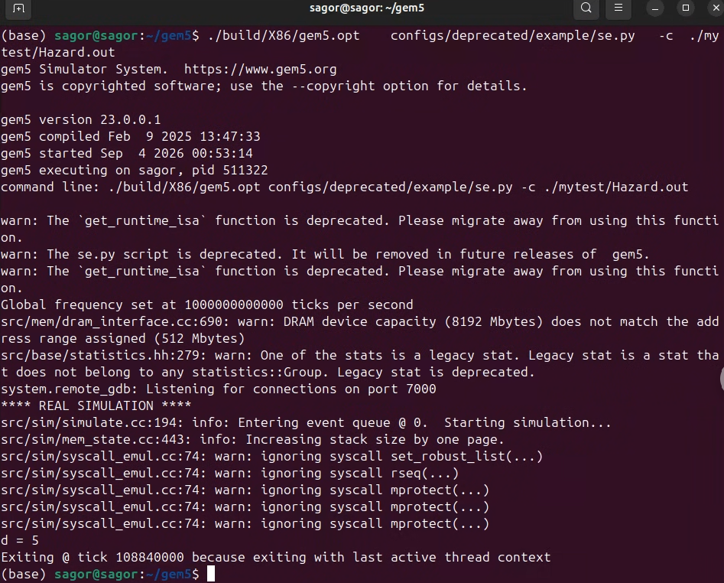
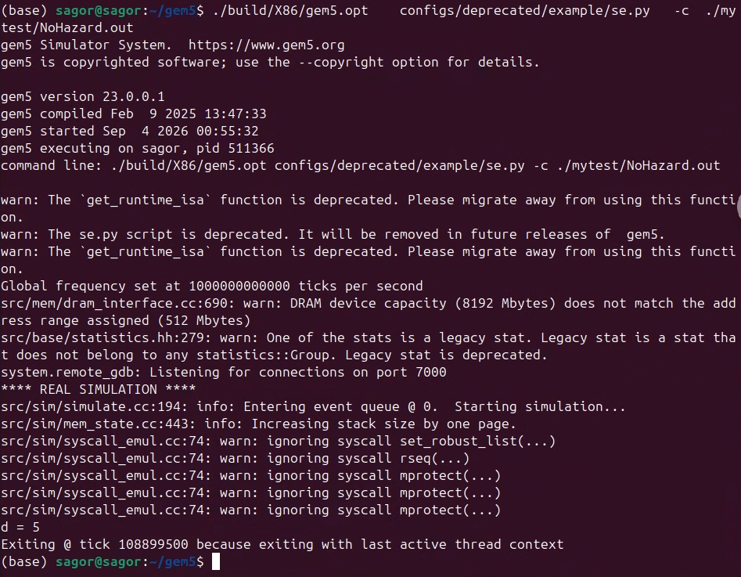
Hazard and NoHazard (C) Code Execution in gem5
Both code were executed in gem5
Red arrow shows total clock cycles, second code is hazard free but requires more time due to temporary variable handling
Now we will use stalls to make the code hazard free

Slide 86
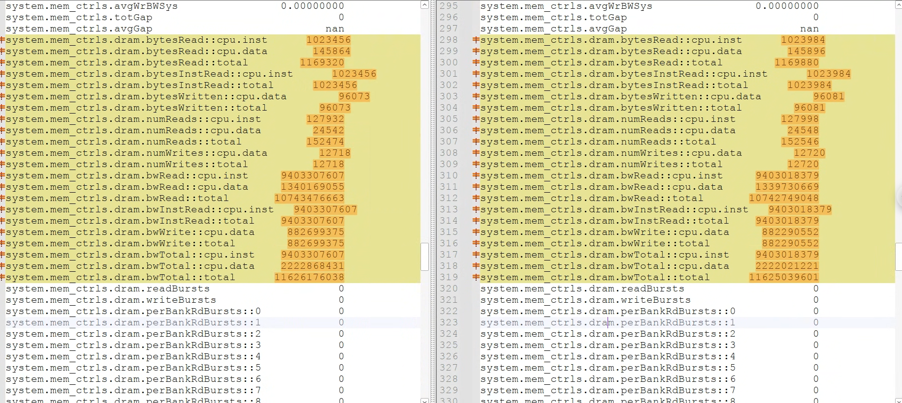
Parameter Selection for Hazard Analysis
Selected Parameters
Misc.Stall: # Number of cycles fetch has spent waiting on interrupts, or bad addresses, or out of MSHRs (Cycle)
TrapStall: # Number of stall cycles due to pending traps (Cycle)
Icache: # ICache total stall cycles (Cycle)
SimTick: # Number of ticks from beginning of simulation (restored from checkpoints and never reset) (Tick)
Hazard Statistics
NoHazard Statistics
Executing Hazard and NoHazrd produces changed values in the stats file (above figure)
All the parameters of the system does not change
Only few parameters have impacts for hazard and non hazard code execution
We have selected several important parameters

Slide 87



Variations of Stall in Code
Single NOP stall
Double NOP stall
Unnecessary NOP stall
Placing stall in different locations
We used “NOP” stall to hold pipeline stage for the variable to be saved properly
Stalls can be place in different location of the code
Placing stall in different location produces different of the selected parameter in gem5 stats.txt file

Slide 88

Parameter Reflection for Variations of Stall
In code variation we place “NOP” as the following location in the code
    Hazard: Code with data hazard
    1nopCor: Single “NOP” placed in the correct position (between involved instructions)
    2nopCor: Double “NOP” placed in the correct position
    'Wrong: All “NOP” placed in wrong location in the code
    RightWrong: Few at correct location, few at wrong location
    ExtraRight: Unnecessary many “NOP” all at correct location
    NoHazard: Parameters for no hazard code
Explanation of the figure
Different colored lines represent different parameter
All parameters tends to lower down values with code variations
Hazard code has the highest execution parameters, no hazard sode has the lowest parameters
Intermediate code variations produced a gradual change in the values
Parameter changes for code variations

Slide 89
Summary
Data hazards come from dependences of variables and removed by renaming
In gem5 execution stall (NOP) used to eliminate data hazard
C codes were executed in gem5 execution parameter are analyzed and selected for data hazard
All types of hazard are not discussed, all mitigation technique were not implemented (gem5)
Codes executed in same system configuration, another system can produce another parameters

Slide 90
Thank you
98

Slide 91
Computer Architecture
with gem5
NEXT-GEN COMPUTING & HARDWARE SECURITY
CORE 0
CORE 1
L1
L1
Hands-on gem5 simulation with AI-guided learning
SHARED L3
Wednesday, Oct 28, 2026
IF
ID
EX
MEM
WB
CORE 2
CORE 3
IF
ID
EX
MEM
WB
L1
L1
10 AM – 2 PM ET
IF
ID
EX
MEM
WB
IF
ID
EX
MEM
WB
FIU EC3930 & on Zoom
IF
ID
EX
MEM
WB

Slide 92
Microarchitectural Security
PART IV · COMPUTER ARCHITECTURE WITH GEM5
PRESENTED BY
Sagor Chandro Bakchy
PhD Student, Florida International University

Slide 93
1
What is attack and why microarchitecture leaks?
Outlines
2
Cache-based side channels: Flush+Reload, Flush+Flush, Prime+Probe, and Evict+Time
3
Timing-based leakage in software
4
Secure microarchitectural design principles
5
Practical evaluation in gem5

Slide 94
What is Side-Channel Attacks?
What is Side-Channel Attacks?
Modern processors use caches, branch predictors, and speculative execution to improve performance
These optimizations create side channels that leak information through hardware behavior
Attacks such as Prime+Probe, and Flush+Reload exploit these channels to infer sensitive data

Slide 95
Why Microarchitecture Leaks?
What traces microarchitecture keeps behind?
Causes of side channels
The instruction set specifies what a program computes and what architectural state it leaves behind.
It says nothing what traces the computation leaves in caches, predictors and buffers.
Those traces were treated as an invisible implementation detail.
1. A resource shared between two security domains.
2. State in that resource that depends on what the victim did.
3. A way for the attacker to observe that state, usually by timing its own accesses.
What information side channel my leak?
Caches retain which lines a program touched.
The hit/miss latency gap makes that retention measurable.
Branch predictors retain which way a branch executed
And more.

Slide 96
Who Attacks, and From Where?
Attacker positions
What the attacker needs
What the attacker does NOT need
Co-resident process on the same machine.
Shared on the same physical core, sharing L1, L2 cache.
A different virtual machine on the same cloud host.
A remote client timing network responses.
A shared microarchitectural resource with the victim.
A victim that does work whose address pattern or duration depends on a secret.
The ability to run the victim repeatedly, to average away noise.
A software vulnerability.
Any write to victim memory. Observation alone is enough for confidentiality loss.
This is precisely why these attacks are hard to fix, there is no bug to patch in the victim.

Slide 97
Cache Side-channel Leakage
What a cache leaks?
Reading the clock for finding access pattern
An L1 hit and a DRAM access differ by roughly two orders of magnitude.
That difference was the entire motivation for building a hierarchy.
Did any instruction touch this address recently?
Repeat across many lines and you recover an access pattern, not just one bit.
Time stamp counter (rdtsc/rdtscp) on x86 give cycle-resolution timing from unprivileged code.
Browsers coarsened their timers, but attackers rebuilt a fine clock from a counting thread.
When the cache access pattern is the secret
Square-and-multiply modular exponentiation touches different code and data depending on each exponent bit.
Any lookup table indexed by secret data has this property, in any language.

Slide 98
Cache Attack 1: Flush + Reload
Flush
Attacker evicts the target
line from the whole
hierarchy with clflush
2. Wait
Victim runs and may or
may not access that line
during the window
3. Reload
Attacker reads the line
and times the access
with rdtscp
4. Threshold
Fast means the victim
touched it, slow means
it did not
Example code snippet:
clflush(addr); // step 1
victim_runs(); // step 2
t0 = rdtscp();
lfence
value = *addr; // step 3
dt = rdtscp() - t0; // step 4
How systems accidentally grant it
The attacker must share the physical page with the victim, because clflush needs an address that maps to the victim's line.
Page deduplication and shared libraries give the attacker a shared page; disabling deduplication across tenants removes most of it.
Flush+Flush is a stealthier variant.
It times clflush itself, which is faster on an uncached line.

Slide 99
Cache Attack 2: Flush + Flush
Same setup as Flush+Reload, but the attacker never touches memory in the measurement step.
Flush
clflush the target line
out of the hierarchy
2. Wait
Victim runs and may or
may not access the line
3. Flush again
clflush the same line and
time the instruction itself
4. Decide
A slow clflush means the
line was present
clflush(addr); // step 1
victim_runs(); // step 2
t0 = rdtscp();
clflush(addr); // step 3, no load
dt = rdtscp() - t0; // step 4
Why give up the reload?
What it costs the attacker
The usual way to catch a cache attack is a performance counter watching for an abnormal cache behavior.
Flush+Reload generates a miss on every probe
Flush+Flush issues no memory access in the measurement step, so it slips past miss-rate monitoring and is faster too.
The cycle gap between a cached and an uncached clflush is far smaller than the hit/miss gap.
That demands careful per-machine calibration and makes it more sensitive to noise.
It needs the shared read-only page, so removing page deduplication defeats it just as it defeats Flush+Reload.

Slide 100
Cache Attack 3: Prime + Probe
One cache set, four ways
Prime
A
A
A
A
attacker fills every way with its own lines
Victim
A
V
A
A
victim access maps to this set and evicts one line
Probe
fast
SLOW
fast
fast
attacker re-reads; one access is slow, so the set was touched
Importance of the attack
Difficulties
It needs no shared memory at all. The attacker uses only its own allocations.
It is a realistic cross-tenant attack in a cloud, where page sharing has been disabled.
On an inclusive last-level cache it works across cores.
Evicting from the LLC forces eviction from the victim's private levels too.
The attacker must first build an eviction set.
The set index depends on physical addresses the attacker cannot see.
It produces noise and needs more repetitions to average out.

Slide 101
Cache Attack 4: Evict + Time
The one technique that times the victim instead of the attacker.
Measure
Trigger the victim and time
its whole run: the baseline
2. Evict
Fill one chosen cache set
with attacker lines
3. Re-run
Trigger the victim again
and time it once more
4. Compare
Slower than baseline means
the victim uses that set
Limitations
Why it still matters
It reveals only that the victim used the evicted set at some point, not when and not how often.
Noise is high, so many repetitions are needed before the difference separates from ordinary jitter.
No clflush and no shared memory, so it works where Flush+Reload cannot.
It also works when clflush is unavailable and eviction sets are hard to build.
It is the natural model for remote timing attacks, where all the attacker sees is how long a request took.

Slide 102
Timing-Based Leakage
// leaks how many bytes matched
for (i = 0; i < 16; i++)
if (tag[i] != expected[i])
return FAIL; // early exit
return OK;
// square-and-multiply leaks exponent bits
if (bit) r = (r * base) % m;
When leaks time?
Why it matters in practice?
Indexing a table with a secret: Two paths differ in length, and they also leave different branch-predictor state.
The cache footprint reveals the index.
A comparison that stops at the first mismatch leaks how many bytes matched.
The integer division, and on some designs floating point, take time that depends on operand values.
Padding-oracle and MAC-comparison timing bugs recur in real protocol implementations to this day.
Averaging defeats noise, so a small bias is still a break given enough queries.

Slide 103
Spectre Attack
if (x < array1_size) {
// trained to predict taken;
// attacker then supplies out-of-range x
secret = array1[x];
junk = array2[secret * 512];
}
When this attack occurs?
Steps of a Spectre v1 attack
A mis predicted branch is squashed and architectural state is rolled back.
Lines fetched during the wrong path stay in the cache.
A squashed instruction can transmit, even though it officially never executed.
1. Train the branch predictor with many in-range values.
2. Supply an out-of-range x; the core speculatively reads a secret byte.
3. The second load indexes array2 by that byte, pulling one line into the cache.
4. The attacker recovers the secret with Flush+Reload over the candidate lines.

Slide 104
Meltdown Attack
When it occurs?
How it was fixed
An out-of-order core issues a load and continues with dependent work before the fault.
On affected designs the loaded value reaches dependent instructions.
A dependent instruction encodes the value into the cache.
The fault eventually retires and the process sees an exception, but the secret is already in the cache.
Software: kernel page-table isolation so that the address is simply not there to load.
The cost is an extra page-table switch on every system call.
Hardware: later designs check permissions before the value is forwarded.
Important factors
Meltdown use delayed fault handling to cross a privilege boundary.
Unlike Spectre, it needs no predictor training and no gadget in the victim.
Meltdown largely disappeared from new hardware.

Slide 105
Secure Microarchitectural Design Principles
Isolate
Randomize
Make secrets oblivious
Constrain speculation
Treat any resource shared across a trust boundary as a channel.
Give each domain its own partition or flush the resource.
Do not share a physical core between trust domains.
Break the attacker's ability to map addresses to cache locations.
Randomized cache indexing, randomized replacement.
Raises attacker cost rather than removing the channel.
Execution time and address pattern must not depend on secret values.
Applies in software as constant-time coding.
In hardware as data-independent timing modes.
Do not let speculative execution cross a security boundary.
Fences, index masking, tagged or flushed predictor state.
Hardware that delays the visible effects of speculative loads.
Apply fences only where needed; fencing everything destroys pipeline performance.

Slide 106
Defense: Partitioning and Flushing
Mechanisms
What it costs
Assign disjoint cache ways to each domain.
Line locking: pin sensitive lines so another domain cannot evict them.
Flush on switch: clear the cache whenever the machine changes trust.
Tagging: extend predictor entries with a domain.
Scheduling: never co-schedule two trust domains on sibling hyperthreads.
Partitioning reduces the effective capacity available to each domain.
Flushing throws away warm state.
Disabling SMT can cost a substantial fraction of throughput.
Strengths and limits
Partitioning gives a deterministic security argument.
If two domains never share a resource, there is no channel through that resource.
No probabilistic reasoning required.
Partitioning the cache leaves the TLB, the predictors and the ports wide open, which is exactly how later attacks were found.
Coverage must therefore be argued resource by resource.

Slide 107
Defense: Randomization
Mechanisms
Why it is attractive
Randomized index mapping: scramble which address maps to which set.
Encrypted set index with periodic remapping. The mapping changes faster than an attacker can build an eviction set.
Skewed randomized caches, which use different mappings in different partitions so a single eviction set cannot exist.
Noise injection and randomized replacement policies.
Steady-state performance cost is low.
It scales to many domains, since there is no per-domain partition to shrink.
It can be applied to resources that are impractical to partition.
It composes with other defenses rather than replacing them.
Difficulties for the attackers
Randomization raises the attacker's cost
Several randomized cache designs were later broken by faster eviction-set construction.
Deterministic defenses lasts better than probabilistic ones, where a strong guarantee is required.

Slide 108
Evaluating Microarchitectural Security in gem5
Why a simulator, when the attacks work on real hardware
Real CPU/chips hides its microarchitecture.
The gem5 lets the instrument to know the exact structures the attack exploits and changes.
We use the following command to configure the system and run the code
./build/X86/gem5.opt \configs/deprecated/example/se.py -c ./covert_channel --cpu-type=DerivO3CPU --caches --l2cache --l1d_size=32kB --l2_size=1MB

Slide 109


Codes, Object Files and Stats of the Attacks

Slide 110

Flush+Reload Attack Code Execution

Slide 111

Flush+Flush Attack Code Execution

Slide 112

Prime+Probe Attack Code Execution

Slide 113

Evict+Time Attack Code Execution

Slide 114

Stats.txt File Analysis
Analysis of the code execution and system parameters
Four types of attacks are executed in the previous 4 slides.
The corresponding output of each type of code are shown in the output terminal screens.
After each execution a stats.txt file is generated.
This file holds all system parameters that is produced for the system
An example of the stats.txt file is shown beside.
This file contains system behavior on specific system configuration on specific code execution

Slide 115
Summary
Microarchitecture leaks because the ISA promises results but says nothing about timing or leftover state.
Flush+Reload gives line resolution but needs shared memory; Prime+Probe needs none and is the realistic cloud attack.
Timing leakage is broader than caches: branches, table lookups, early exits and variable-latency instructions all leak.
Design principles: isolate, randomize, make secrets oblivious, constrain speculation, and put leakage in the contract.
Every defense trades performance for isolation, so report leakage and cost together or the evaluation is incomplete.

Slide 116
Thank you
98

Slide 117
Computer Architecture
with gem5
NEXT-GEN COMPUTING & HARDWARE SECURITY
CORE 0
CORE 1
L1
L1
Hands-on gem5 simulation with AI-guided learning
SHARED L3
Wednesday, Oct 28, 2026
IF
ID
EX
MEM
WB
CORE 2
CORE 3
IF
ID
EX
MEM
WB
L1
L1
10 AM – 2 PM ET
IF
ID
EX
MEM
WB
IF
ID
EX
MEM
WB
FIU EC3930 & on Zoom
IF
ID
EX
MEM
WB

Slide 118
AI Scaffolding Learning
PART V · COMPUTER ARCHITECTURE WITH GEM5
PRESENTED BY
Sagor Chandro Bakchy
PhD Student, Florida International University

Slide 119

AI Scaffolding in Local Computer
Primary interface to SCALE-UP tool

Slide 120

AI Scaffolding in Local Computer
Input code, output, RegEx feedback and LLM feedback in the upper 3 boxes
Output statistics in lower box

Slide 121

AI Scaffolding in Local Computer
When your submitted code consists of any error

Slide 122

AI Scaffolding in Local Computer
LLM feedback for each submission is stored in .md file

Slide 123

AI Scaffolding in Local Computer
Preliminary hosting of SACLE-UP tool in FIU server (https://serlop-cats.fiu.edu/form.html)
Accessible from FIU network only

Slide 124
Thank you
PART I · INTRODUCTION TO GEM5
Questions & discussion
98

Slide 125
Computer Architecture
with gem5
NEXT-GEN COMPUTING & HARDWARE SECURITY
CORE 0
CORE 1
L1
L1
Hands-on gem5 simulation with AI-guided learning
SHARED L3
End of the Event
CORE 2
CORE 3
L1
L1

